Slide 1
TOCOI CREEK HIGH SCHOOL
2021 – 2022 Open House
English
Porcellini

Slide 2
ABOUT ME Ms. Porcellini
Alaina Porcellini grew up in Orlando, Florida. She then moved to St. Augustine for College where she earned a Bachelors degree in Secondary English Education from Flagler College.
Ms. Porcellini began her career teaching English at Green Cove Junior High. She then moved into teaching English ad Speech at Nease where she also coached cheerleading for 2 years. Ms. Porcellini cannot wait to join the Herd at Tocoi Creek and is so excited to be apart of new beginnings.
In her spare time, she enjoys spending time with family and friends, going to the beach, traveling, hiking, and being on the water!
Go Toros
CLICK ICON TO ADD PICTURE

Slide 3
COMMUNICATION AND PARENT CONFERENCES
Teacher email: Alaina.Porcellini@stjohns.k12.fl.us
Teacher Available times: 8:30 am-9:20 am
Please be checking schoology and Hac for any additional information
IT IS IMPORTANT TO NOTE THAT ST. JOHN’S COUNTY SCHOOL DISTRICT TEACHERS HAVE UP TO 48 SCHOOL HOURS TO RESPOND TO A REQUEST FOR CONTACT. PLEASE DO NOT SUBMIT TIME SENSITIVE CONCERNS VIA EMAIL.

Slide 4
ENGLISH 2 YEAR AT A GLANCE
QUARTERLY BREAKDOWN WITH MAJOR TOPICS COVERED
Q1 Standards Focus: Theme and Layers of Meaning
Q2 Standards Focus: Argument and Persuasion
Q3 Standards Focus: Narrative Writing
Q4 Standards Focus: Central Idea (Informational Text)
SJCSD YEAR AT A GLANCE: https://www.stjohns.k12.fl.us/year-at-a-glance/

Slide 5
ENGLISH 3 YEAR AT A GLANCE
QUARTERLY BREAKDOWN WITH MAJOR TOPICS COVERED
Q1: Breaking Away: How does independence define the American spirit?
Q2: The Art of Persuasion: How do we influence others?
Q3: Living the Dream: What does home mean to you?
Q4: With Malice Toward None - How can we attain justice for all?
SJCSD YEAR AT A GLANCE: https://www.stjohns.k12.fl.us/year-at-a-glance/

Slide 6
GRADING
70% Summative (After-learning checks)
30 % Formative (During-learning checks)

Slide 7
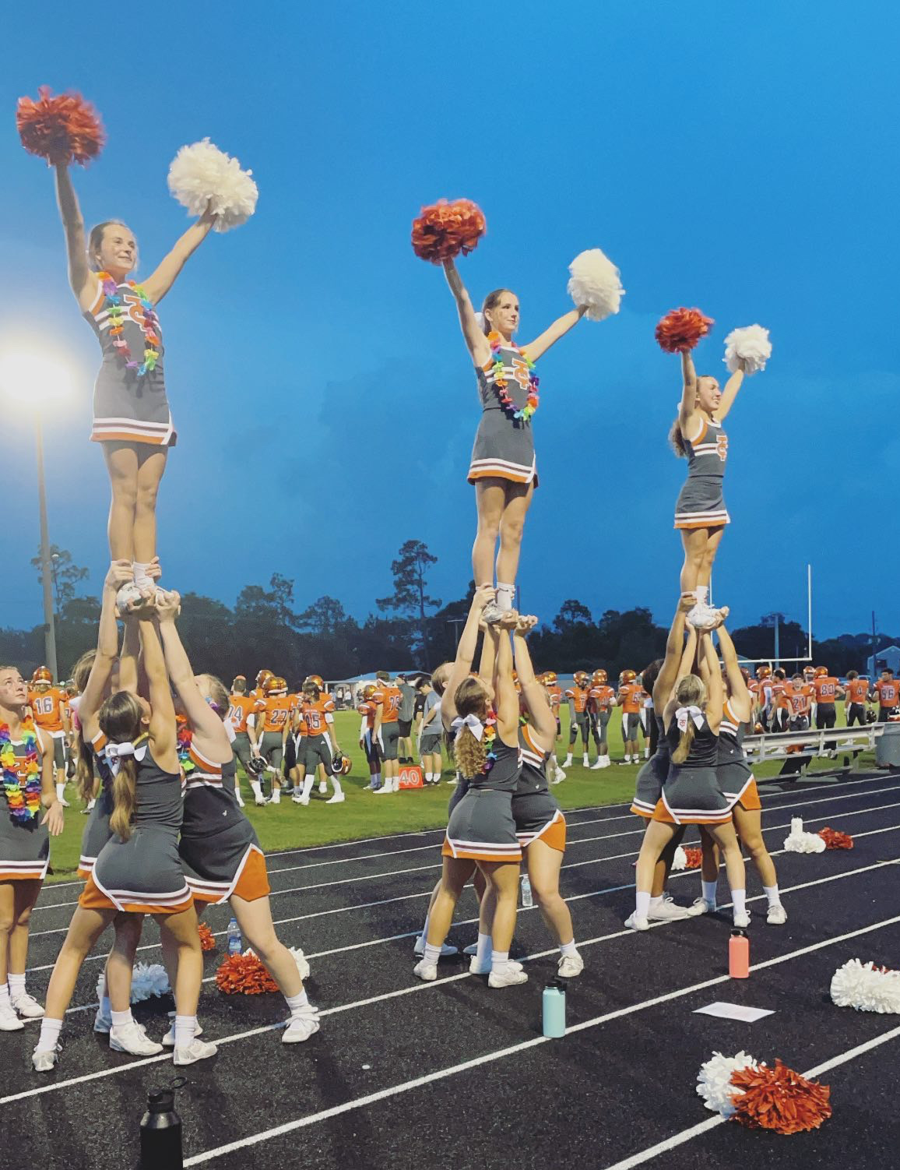
THANK YOU!
IT IS A PLEASURE TO PARTNER WITH YOU IN THIS YEAR’S EDUCATIONAL JOURNEY. WE APPRECIATE YOUR CONTINUED SUPPORT.
HORNS UP…TOCOI!

