Slide 1
TOCOI CREEK HIGH SCHOOL
2021 – 2022 Open House
Robotics Design Essentials
Jeramy Brux

Slide 2
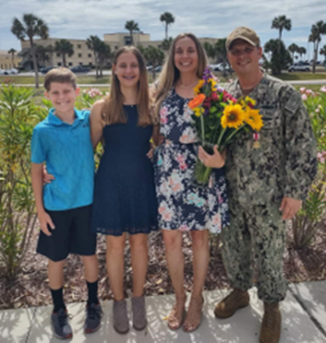
ABOUT YOUR TEACHER
CLICK ICON TO ADD PICTURE
Jeramy Brux grew up in Illinois and Wisconsin. He enlisted in the Navy in 1997 and served 24 years. He served on submarines as a Nuclear Power Plant Operator. In 2007, he earned a commission and served as a Surface Warfare Officer on cruisers and destroyers stationed in Mayport, Florida. He has taught various technical subjects in Navy schools.
Mr. Brux earned a Bachelors in Business Administration in Management from Jacksonville University and a Masters of Science in Systems Engineering Analysis from the Naval Postgraduate School in Monterey, CA. He is fascinated with technology and excited to be in his first year teaching high school as a Tocoi Creek Toro!
He and his wife Alicia, their children, Ariana and Caleb enjoy spending time together as much as they can. Much of their time is occupied tending to their two rambunctious Corgis, Ferris and Moira!

Slide 3
COMMUNICATION AND PARENT CONFERENCES
TEACHER EMAIL: jeramy.brux@stjohns.k12.fl.us
TEACHER AVAILABLE TIMES: 0800 until school start, by appointment all other times.
If your student needs additional instruction or to make-up work I am flexible. The key is that your student arranges with me personally a time that fits their schedule.
IT IS IMPORTANT TO NOTE THAT ST. JOHN’S COUNTY SCHOOL DISTRICT TEACHERS HAVE UP TO 48 SCHOOL HOURS TO RESPOND TO A REQUEST FOR CONTACT. PLEASE DO NOT SUBMIT TIME SENSITIVE CONCERNS VIA EMAIL.

Slide 4
ROBOTIC DESIGN ESSENTIALS YEAR AT A GLANCE
QUARTERLY BREAKDOWN WITH MAJOR TOPICS COVERED
Q1: Safety, electricity and electronic components, robotics history, sensors, motors, gears, servos, circuit building and coding
Q2: Switches and relays, end-of-arm tooling, peripherals, decision logic, basic coding and programming, robot operation, troubleshooting, circuit building, robot building and coding
SJCSD YEAR AT A GLANCE: https://www.stjohns.k12.fl.us/year-at-a-glance/

Slide 5
ROBOTIC DESIGN ESSENTIALS YEAR AT A GLANCE
QUARTERLY BREAKDOWN WITH MAJOR TOPICS COVERED
Q3: Justifying the use of the robot, repairing the robot, unmanned aerial system (uas) foundations, uas aerodynamics and performance, uas components, uas operations environment
Q4: FAA regulations 14 CFR part 107, national airspace, human factors and crew resource management, aeronautical decision making, ethical and legal requirements, datalinks, electromagnetic spectrum, control station, payloads, uas safety certification exam
SJCSD YEAR AT A GLANCE: https://www.stjohns.k12.fl.us/year-at-a-glance/

Slide 6
HOMEWORK
All textbook and lab instruction reading is assigned as homework. It is critical that students conduct the reading and come to class prepared to learn and discuss the material.
Outside of reading, there will be little work assigned outside of class.

Slide 7
GRADING
Per Saint Johns County School District policies
70% Summative
Test
Research papers/presentations
Project
30% Formative
Quizzes
Labs

Slide 8
Keys to success in this course
Follow the agenda posted on Schoology
Use the unit scales as a guide
Read the assigned pages from the textbook
Do the recommended homework questions
Pay attention and take notes as necessary in class
When given class time to work on assignments make effective use of that time
Participate in labs and turn in your lab notebook
Work hard but have fun!

Slide 9
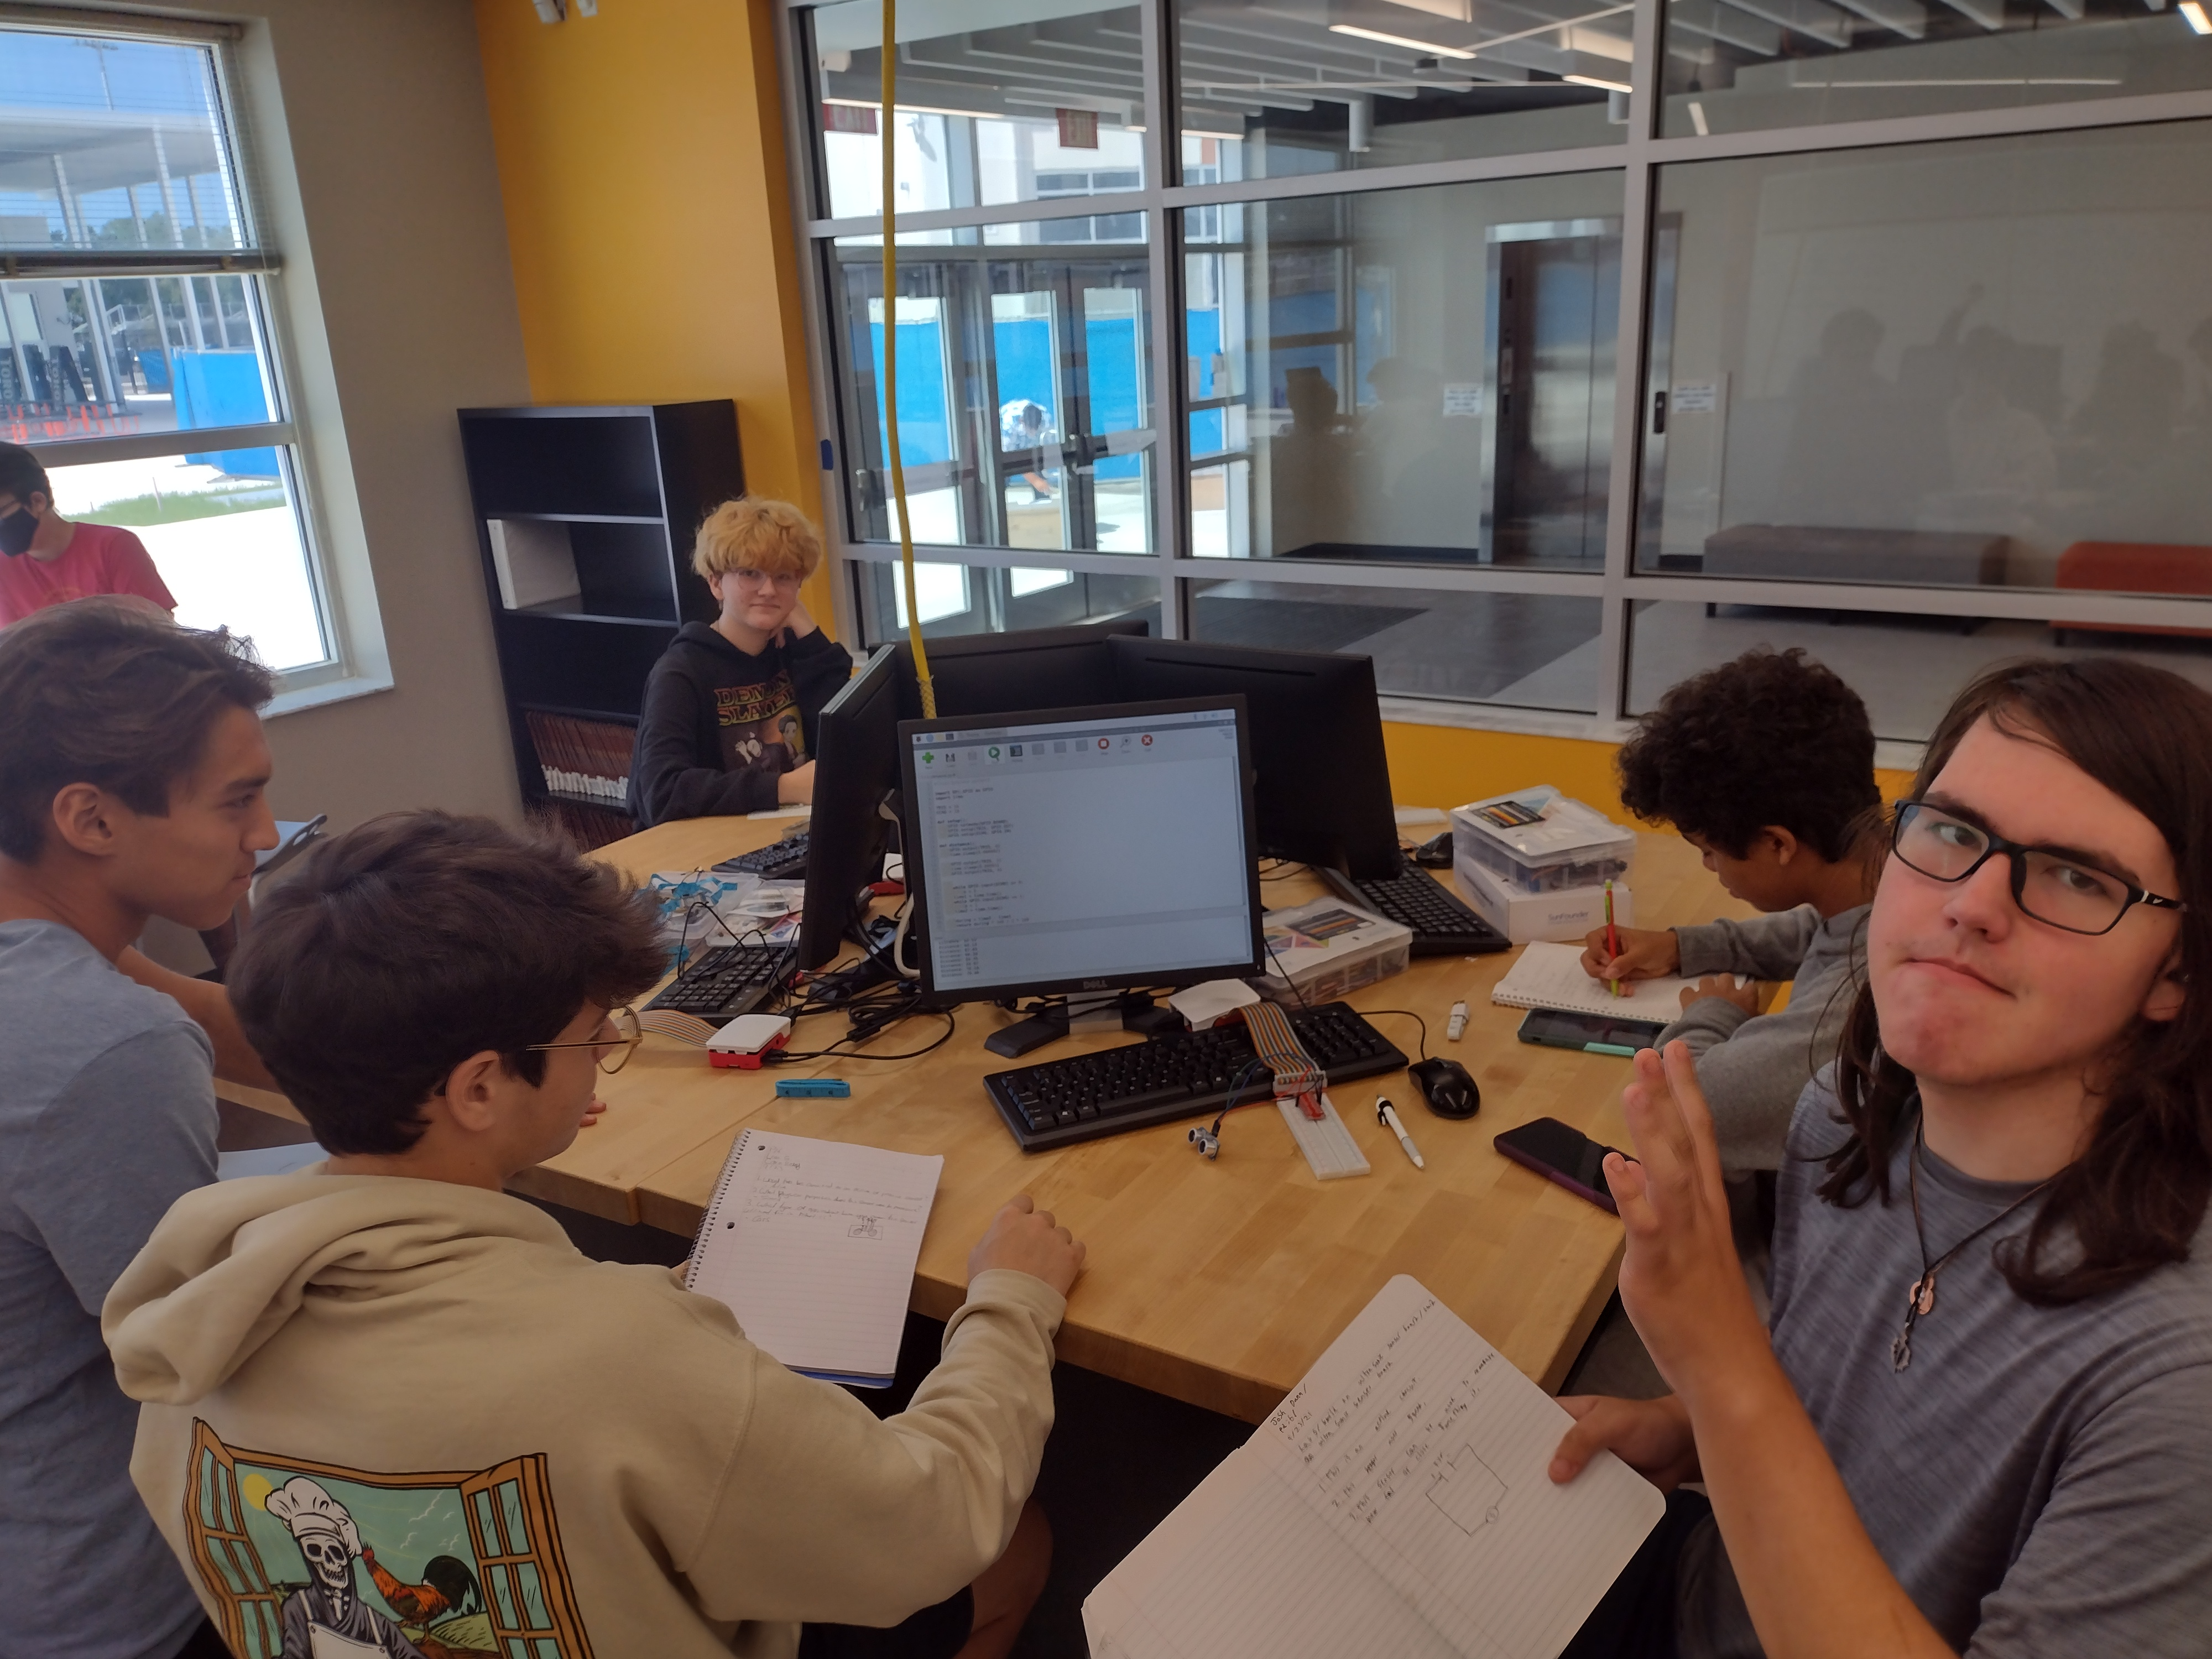
Course Happenings….
So far, your student has learned some basic robotics concepts along with basic electricity and electronics. Each week they are building on their knowledge and building circuits with more advanced components. It has been awesome to watch them discover the technical world around them!
Students build an ultrasonic sensor circuit

Slide 10
THANK YOU!!
THANK YOU FOR YOUR CONTINUED SUPPORT OF YOUR STUDENT AND THIS ACADEMY!
HORNS UP…TOCOI!
Students build a liquid crystal display circuit

