Slide 1
Tocoi Creek High School
2021-2022 Open House
Chemistry
Allan Levy

Slide 2
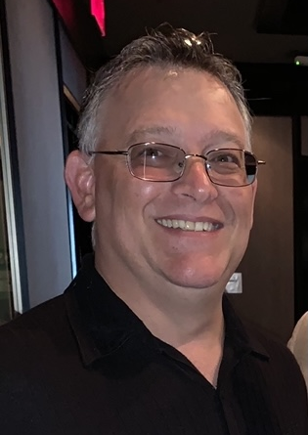
Dr. Levy
Dr. Levy was born in Michigan and grew up in South Florida. He attended University of Florida and Florida Atlantic University, earning a B.A in Business Management and Pre-Medical Studies. He then went off to Cleveland, OH to earn his Doctor of Podiatric Medicine from Kent State University. Residency and Fellowship followed in Brooklyn, NY, and Chicago IL.
Dr. Levy’s first career was practicing podiatric medicine in Chicago, IL, Boynton Beach FL, and Jacksonville FL. Dr. Levy’s switch to education led him to teaching one year in Palm Beach County as a middle school science teacher and the last four years as mainly a chemistry teacher at Ponte Vedra High School.
Dr. Levy enjoys living in the World Golf Village area with his daughter, Lexi., and two dogs, Mia and Bolt. As often as possible, we like traveling back down to South Florida to visit family and friends, and attend live sporting events and musical performances.

Slide 3
Communication and Parent Conferences
Allan.levy@stjohns.k12.fl.us
I usually respond the same day
Make sure to check Schoology regularly especially if a student is absent
It is important to note that St. John’s County School District Teachers have up to 48 school hours to respond to a request for contact. Please do not submit time sensitive concerns via email.

Slide 4
Chemistry
Q1: Nature of Science, Physical/Chemical Properties, Atomic theory
Q2: EMS and the Electron, Periodic Table Trends, Chemical Bonding
Q3: Chemical Reactions, The Mole and Stoichiometry, Gas Laws
Q4: Energy, Acid/Base, Nuclear Chemistry
SJCSD Year at a Glance: https://www.stjohns.k12.fl.us/year-at-a-glance/

Slide 5
Homework
Homework will usually be to finish the day’s classwork

Slide 6
Grading
No retakes on formatives
Retakes on summatives up to an 85
Any formative score will get grade replaced with the summative grade (Given the summative grade is higher than the formative)

Slide 7
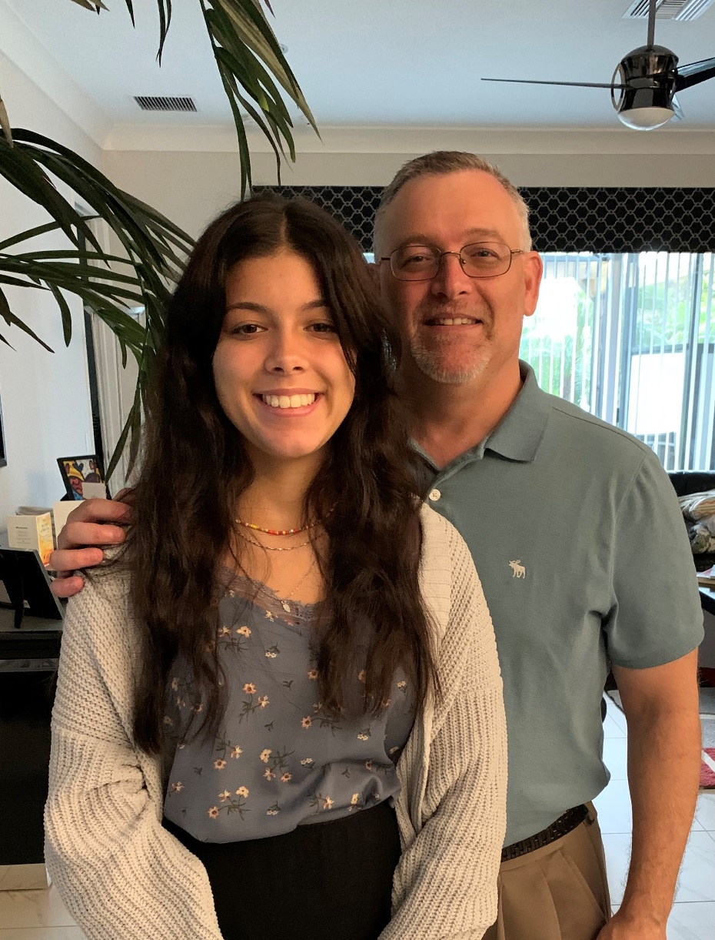
Thank you!
It is a pleasure to partner with you in this year’s educational journey. We appreciate your continued support.
Horns Up…. T.o.c.o.i!

