Slide 1
TOCOI CREEK HIGH SCHOOL
2021 – 2022 Open House
Digital, 2d and 3d Art
Mrs. Post

Slide 2
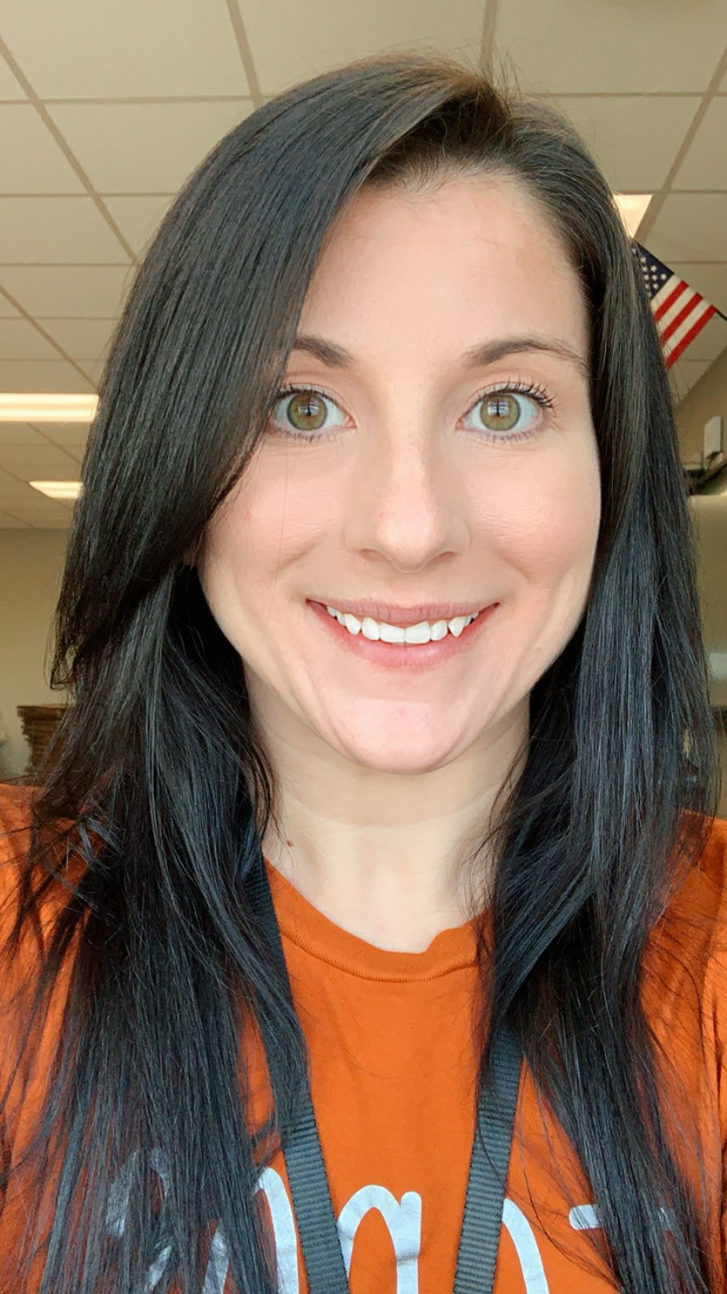
About Me:
Art is a way to “Express” what you cannot say into words. I have had a passion for art since I was a little girl. I originally grew up in New Jersey and became a Floridian about 15 years ago. While I was in grade school, there wasn’t a year where I did not take an art class. I continue my passion for art, and I went to Jacksonville University where I received my Bachelor of Fine Arts in Graphic Design. From there I went to pursue my teaching certificate in art. I have now been teaching for 10 years and enjoy working with my students building their artistic abilities.

Slide 3
COMMUNICATION AND PARENT CONFERENCES
Email: Julia.Post@Stjohns.k12.fl.us
Teacher Available Time: 8:30-9:15 am
IT IS IMPORTANT TO NOTE THAT ST. JOHN’S COUNTY SCHOOL DISTRICT TEACHERS HAVE UP TO 48 SCHOOL HOURS TO RESPOND TO A REQUEST FOR CONTACT. PLEASE DO NOT SUBMIT TIME SENSITIVE CONCERNS VIA EMAIL.

Slide 4
Digital Art
Students explore the fundamental concepts, terminology, techniques, and applications of digital imaging to create original work. Students produce digital still images through the single or combined use of computers, digital cameras, scanners, photo editing software, drawing and painting software, graphic tablets, printers, new media, and emerging technologies. Through the critique process and students evaluate
SJCSD YEAR AT A GLANCE: https://www.stjohns.k12.fl.us/year-at-a-glance/

Slide 5
2D Studio 1
Students experiment with the media and techniques used to create a variety of two-dimensional (2-D) artworks through the development of skills in drawing, painting, printmaking, collage, and/or design. Students practice, sketch, and manipulate the structural elements of art to improve mark making and/or the organizational principles of design in a composition from observation, research, and/or imagination. Through the critique process, students evaluate and respond to their own work and that of their peers. This course incorporates hands-on activities and consumption of art materials.
SJCSD YEAR AT A GLANCE: https://www.stjohns.k12.fl.us/year-at-a-glance/

Slide 6
Creating 3D Art
Students in Creating Three-Dimensional Art, investigate a wide range of media and techniques, from both an historical and contemporary perspective, as they engage in the art-making processes of creating 3-D artworks, which may include sculpture, assemblage, and/or ceramics. Student artists reflect on their own artwork and that of others through critical analysis to achieve artistic goals related to craftsmanship, technique, and application of 21st-century skills. This course incorporates hands-on activities and consumption of art materials.
SJCSD YEAR AT A GLANCE: https://www.stjohns.k12.fl.us/year-at-a-glance/

Slide 7
GRADING
Tests: A = 100-90; B = 89-80; C = 79-70; D = 69-60; F = 59-0
Projects & Assignments are graded based on a provided rubric.
Exemplary- all points are met under this category.
Intermediate- all points are met for this category.
Progressing- all points are met for this category.
Needs improving- all points are met for this category.
Originality, creativity, craftsmanship, completion, meeting Learning objectives, and thinking critically are key components for success in art courses. Visual journals, sketchbooks, portfolios and classroom critiques are required and will direct students towards professional art practices, and encourage analytical and critical thinking.
Please be sure to submit Projects by Due Date. Late projects will decrease a letter grade with each passing day.
Artwork will not be accepted 10 days passed the due date

Slide 8
THANK YOU!
IT IS A PLEASURE TO PARTNER WITH YOU IN THIS YEAR’S EDUCATIONAL JOURNEY. WE APPRECIATE YOUR CONTINUED SUPPORT.
HORNS UP…TOCOI!

