Slide 1
TOCOI CREEK HIGH SCHOOL
2021 – 2022 Open House
School Counseling
D’Erica Gibbs (Last Names A-L) and
Linda M. Smith (Last Names M-Z)

Slide 2
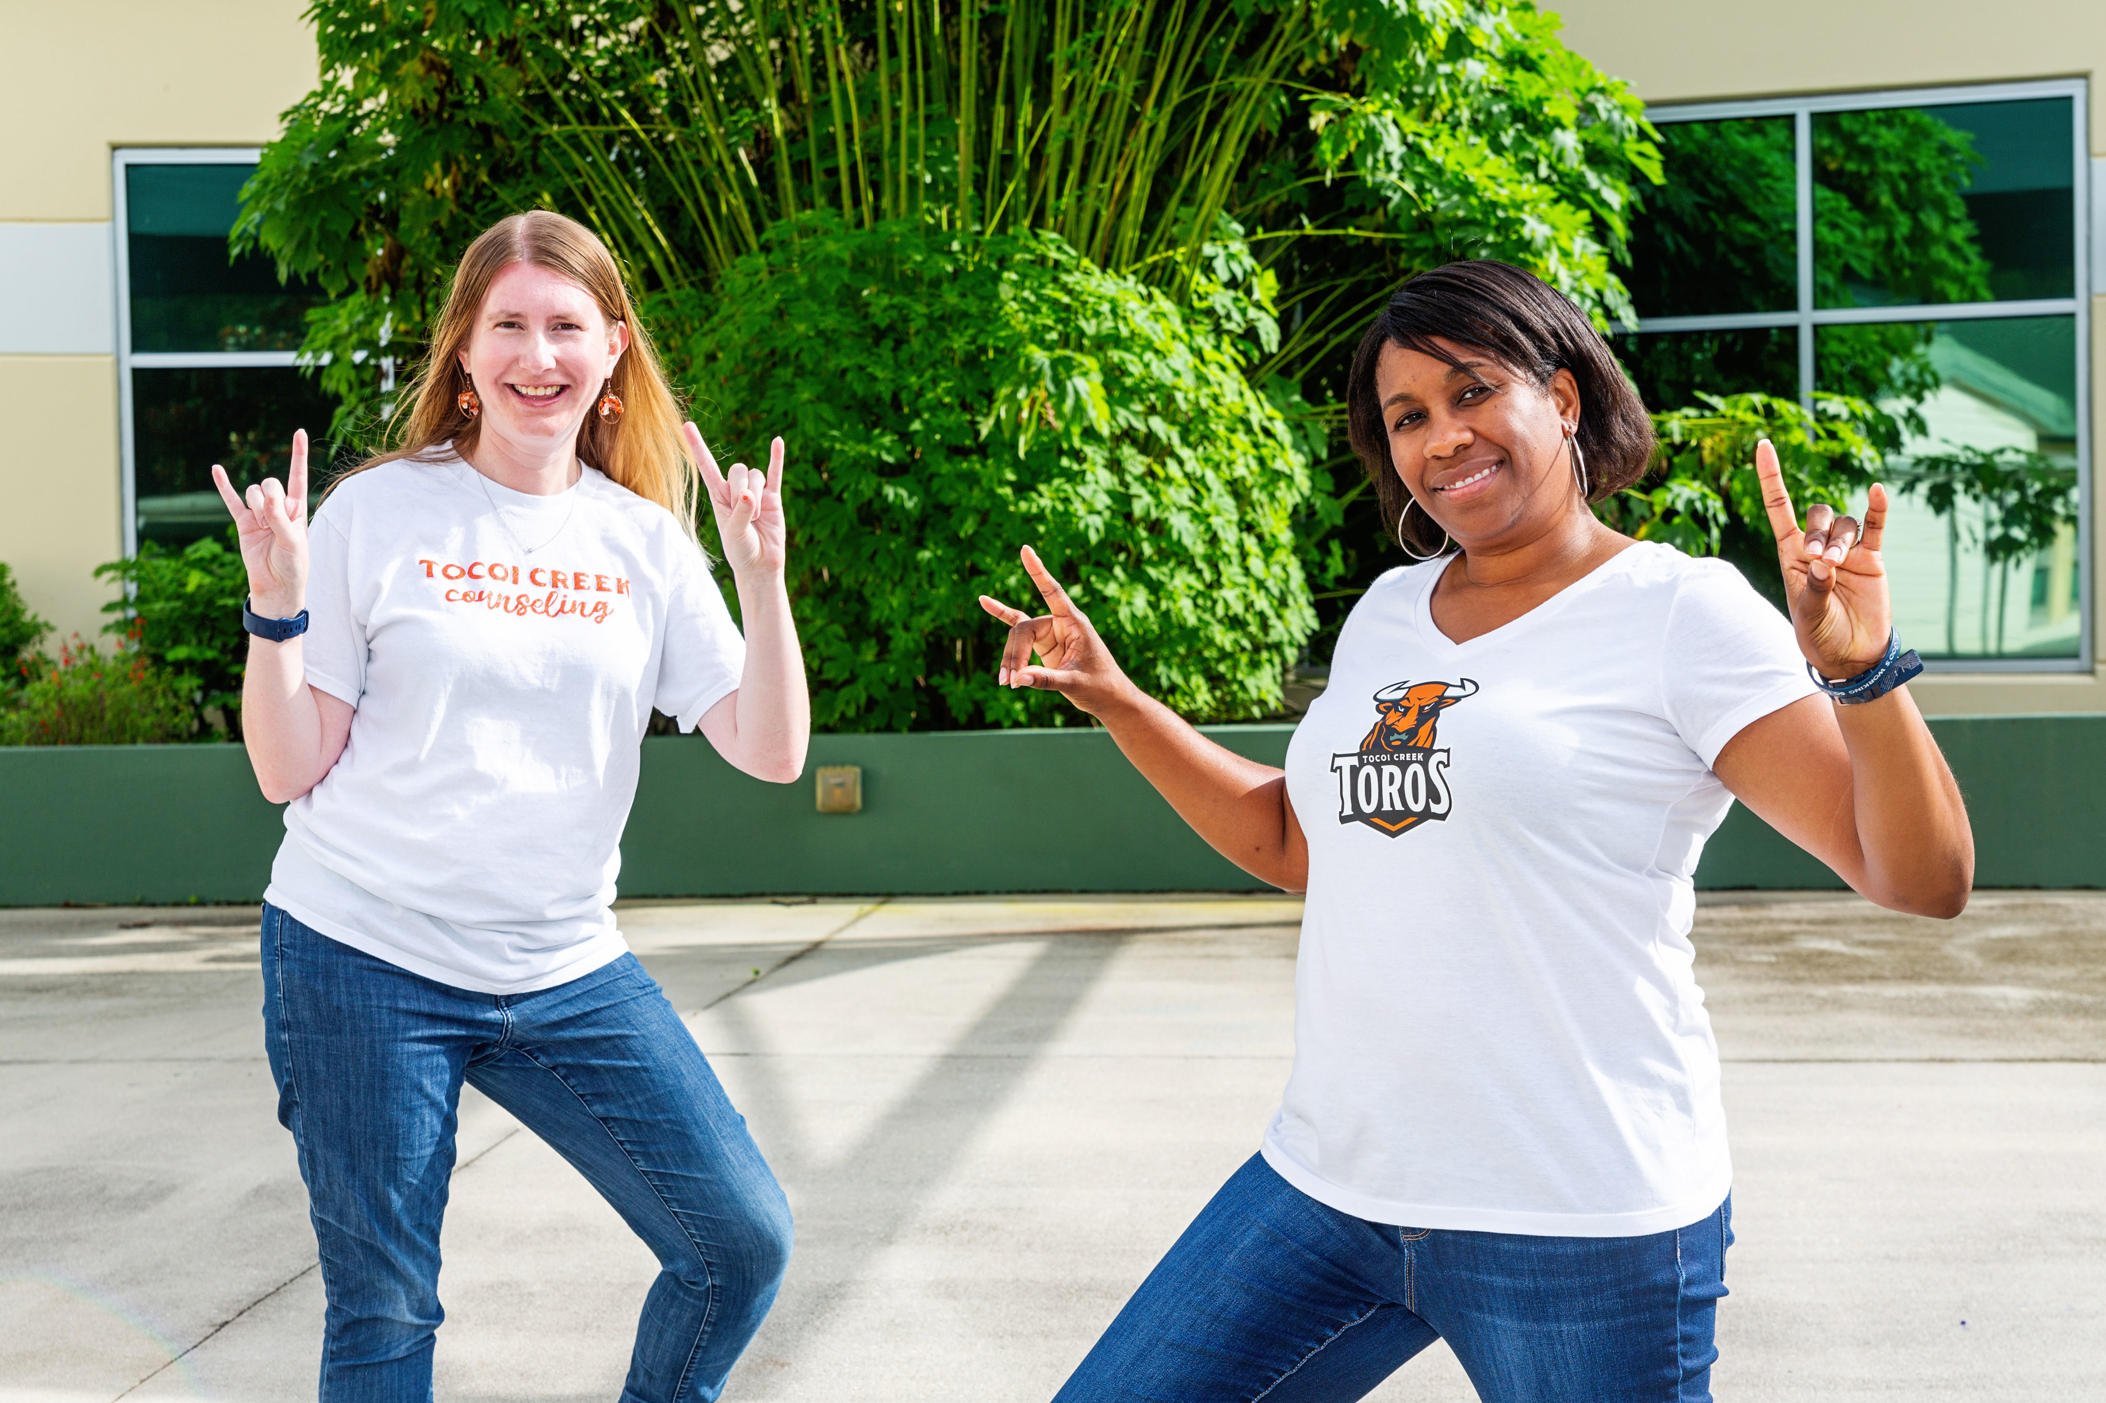
ABOUT US
Mrs. Gibbs’ was a military child growing up along the East Coast. She graduated high school from Virginia Beach, VA and pursued undergraduate studies at Davidson College. Additionally, she earned master’s degrees in Special Education and School Counseling. She has teaching and counseling experience with students in grades 9-12. Mrs. Gibbs and her family moved to St. Johns County six years ago. She was a counselor at Nease for four years and is excited to be a part of building a tradition with Tocoi Creek High School. Mrs. Gibbs, her husband, Darrick, and three children spend much of their free time at some athletic facility. As a family, they enjoy traveling, playing board games, and visiting family and friends.
Mrs. Smith grew up “locally” in nearby Orange Park. She has a bachelors degree in Psychology and a Masters in School Counseling from UNF. Coming most recently from Nease High School, this is her 13th year as a high school counselor. She has a 12-year-old daughter and 6-year-old son that I share with my husband of 17 years. Our family enjoys traveling and playing computer games together. She is really enjoying being a Toro and helping to establish the traditions of Tocoi Creek.
Mrs. Smith
Mrs. Gibbs

Slide 3
COMMUNICATION AND PARENT CONFERENCES
Contact us through email:
D’Erica Gibbs: Derica.Gibbs@stjohns.k12.fl.us
Linda M. Smith: Linda.M.Smith@stjohns.k12.fl.us
Parent Conferences:
If you want to meet with just one teacher, contact that teacher directly.
If you want to meet with just the counselor or multiple teachers, use the links below:
D’Erica Gibbs: https://calendly.com/derica-gibbs-1
Linda M. Smith: https://calendly.com/lindamsmith
IT IS IMPORTANT TO NOTE THAT ST. JOHN’S COUNTY SCHOOL DISTRICT TEACHERS HAVE UP TO 48 SCHOOL HOURS TO RESPOND TO A REQUEST FOR CONTACT. PLEASE DO NOT SUBMIT TIME SENSITIVE CONCERNS VIA EMAIL.

Slide 4
FRESHMAN YEAR AT A GLANCE
QUARTERLY BREAKDOWN WITH MAJOR TOPICS COVERED
Q1: Counselor introductions, graduation requirements, and goal setting.
Q2: Making friends and career planning
Q3: Registration for 22-23 Courses
Q4: Test taking strategies
SJCSD YEAR AT A GLANCE: https://www.stjohns.k12.fl.us/year-at-a-glance/

Slide 5
SOPHOMORE YEAR AT A GLANCE
QUARTERLY BREAKDOWN WITH MAJOR TOPICS COVERED
Q1: Counselor introductions, Sophomore year goals & planning, PSAT preparation
Q2: Discovering your interest, graduation requirements, etc.
Q3: Registration for 22-23 Courses
Q4: Test taking strategies
SJCSD YEAR AT A GLANCE: https://www.stjohns.k12.fl.us/year-at-a-glance/

Slide 6
JUNIOR YEAR AT A GLANCE
QUARTERLY BREAKDOWN WITH MAJOR TOPICS COVERED
Q1: Introductions, Year at a glance, Community Service
Q2: Individual student meetings: career interests and next steps
Q3: Registration for 22-23 courses.
Q4: Individual student meetings: Getting ready for college application season and senior year next steps
SJCSD YEAR AT A GLANCE: https://www.stjohns.k12.fl.us/year-at-a-glance/

Slide 7
School Counseling Resources
Visit our Website: https://www-tchs.stjohns.k12.fl.us/guidance/
Includes monthly newsletters, classroom guidance information, community service information, graduation requirements, test prep resources, etc.
Visit our Schoology page: In your Schoology account, click on groups
Includes classroom guidance information, community service information, college resources, opportunities for students, test prep resources, etc.

Slide 8
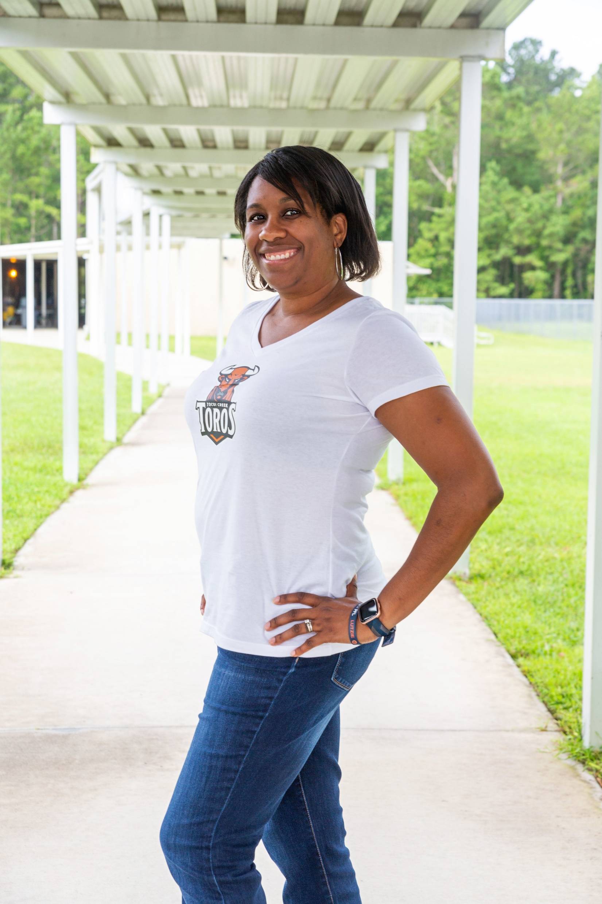
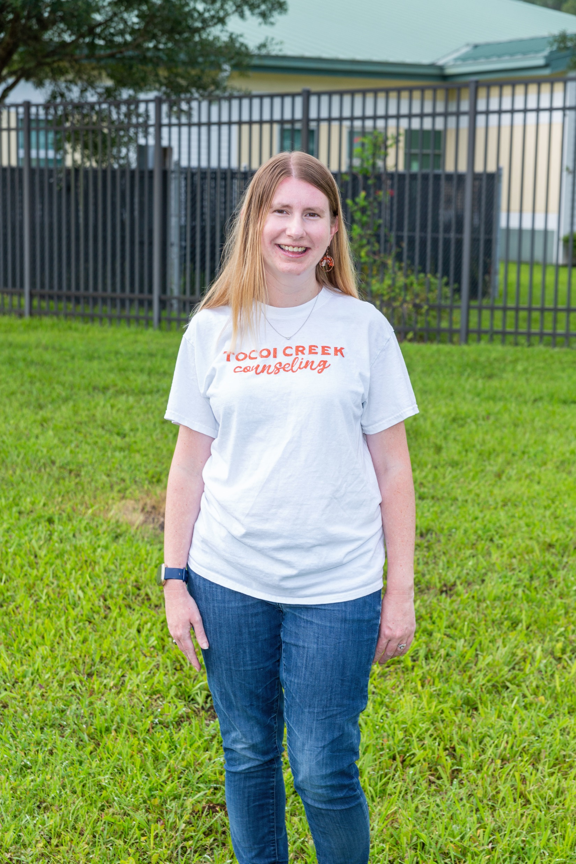
THANK YOU!
IT IS A PLEASURE TO PARTNER WITH YOU IN THIS YEAR’S EDUCATIONAL JOURNEY. WE APPRECIATE YOUR CONTINUED SUPPORT.
HORNS UP…TOCOI!

