Slide 1
Tocoi Creek High School
2021-2022 Open House
SPANISH 1/Leadership development
Mr. mills

Slide 2
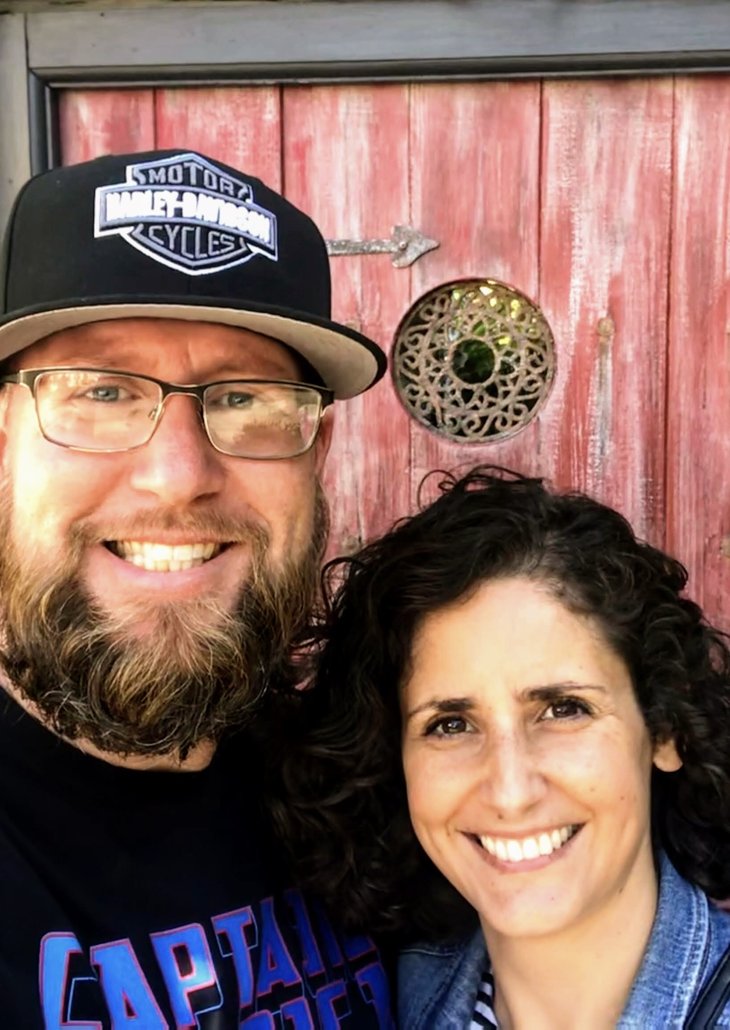
About Me (Teacher)
Mr. Mills was born and raised in Jacksonville. He graduated from Douglas Anderson School of the Arts before going on to study music at Tennessee Temple University. After college he studied and lived abroad for several years in Portugal and Argentina. Living overseas helped him discover his passion for language, culture, and maybe even food.
He and his wife Isabel have three daughters (Lydia, Lia, and Lily), a poodle (Gaston), and a ball python (Beatrice).

Slide 3
Communication and Parent Conferences
Teacher email: William.mills@stjohns.k12.fl.us
I am usually available before school starts each day.
It is important to note that St. John’s County School District Teachers have up to 48 school hours to respond to a request for contact. Please do not submit time sensitive concerns via email.

Slide 4
SPANISH 1
Here are just a few of the things we will be covering this year.
Quarterly break down with major topics covered.
Q1: Greetings, Common phrases, cognates
Q2: pronouns, ser, estar, food and drinks
Q3: hacer, leisure activities, sports, IR
Q4: family, tener, describing things and people,
SJCSD Year at a Glance: https://www.stjohns.k12.fl.us/year-at-a-glance/

Slide 5
Leadership development
Here are just a few of the things we will be covering this year.
Quarterly break down with major topics covered.
Q1: leadership skills, parliamentary procedures
Q2: problem solving, decision making, communication skills
Q3: group dynamics, time management, stress management
Q4: public speaking, community projects, debate
SJCSD Year at a Glance: https://www.stjohns.k12.fl.us/year-at-a-glance/

Slide 6
Grading
Three summative assessments per quarter
Two graded formative assignments prior to the summative
Category weights
  70% Summative, 30% Formative

Slide 7
Thank you!
It is a pleasure to partner with you in this year’s educational journey. We appreciate your continued support.
Horns Up…. T.o.c.o.i!

