Slide 1

11th grade
What’s next?
Class of 2026

Slide 2
ENGLISH
4 years
MATH
Algebra
Geometry
2+ Math
(it is recommended to take Math every year for the strongest college application)
SCIENCE
Biology
+2 others (Chemistry is required for most colleges)
(4 years of science is recommended for competitive colleges)
SOCIAL SCIENCES
World History
US HISTORY
Government/Economics (.5/.5)
PERFORMING/
PRACTICAL ART
One FULL CREDIT worth
HOPE
One FULL CREDIT worth
ELECTIVES
8 FULL credits
WORLD LANGUAGE
2 years required of same language for BRIGHT FUTURES and 4- year University admit
GRADUATION REQUIRMENTS

Slide 3
WHAT’S MISSING?
Think about your course progression based on your plan for next steps
Colleges and military academies expect 5 academic courses every year of high school
Extracurricular involvement should be a few with deep rooting and advancement
Some programs require an audition or portfolio -prepare it now
Start thinking about your essay topics
FCTC/Trade School/SJR/FSCJ

Slide 4
















Colleges want…
Students who APPLY EARLY!
Consider UNF’s “apply in July”
Early Action deadlines are in October/November of senior year.
Well-rounded students
Extra-curricular and leadership activities
Quality, not Quantity
Strong GPA
Test scores (ACT, CLT, and SAT)
Rigorous of Courses
(Dual Enrollment, AP, Honors, 2-3 years of a World Language)
Your Essay. Your story.
Teacher recommendations for some schools

Slide 5
AP or DE
Success in either of these courses requires independent student learning and motivation
and is not suggested for those who need lots of support and reminders
Dual Enrollment (DE)
Advanced Placement (AP)
Dual Enrollment(DE) is a program that allows high school students to take college courses and earn college credit (based on grade earned) while still in high school.
State required Credit
College GPA starts
Potential College credit (dependent upon grade and college of choice)
Increased rigor without heavy exam
Advanced Placement (AP)
are college-level courses offered in high school, culminating in an exam for potential college credit(based on exam score).AP EXAM SEARCH
Nationally recognized
Increased rigor
Self-motivation/Self-study
Rigorous exam for potential college credit
Heavy workload

Slide 6
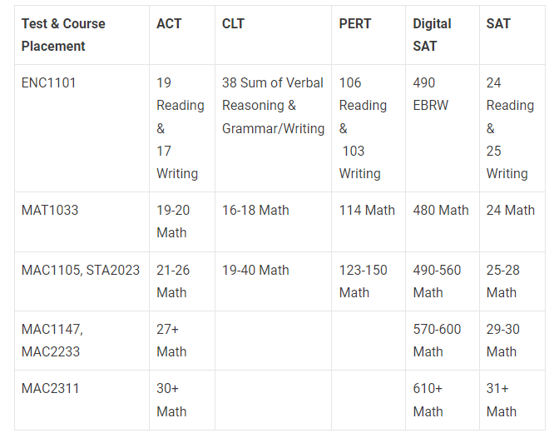
SJR Dual Enrollment
LOOKING TO THE FUTURE
Are you eligible?
Academic Eligible Test Scores
3.0 GPA Unweighted
Test Scores (ACT,SAT,CLT,PERT)
Tocoi Student
Approved by School Counselor and Administration
Electives only require a test score
Academic courses have an eligible test score
Tocoi courses will not be changed due to issues with SJR availability –scheduling is limited
Join TCHS Schoology DE page- RCGS-QGPH-RZCG6

Slide 7
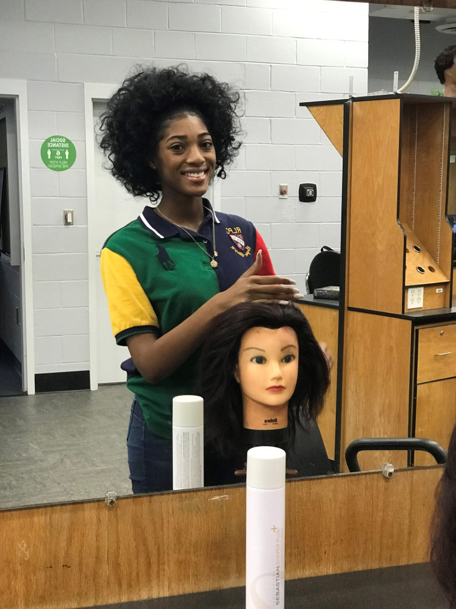

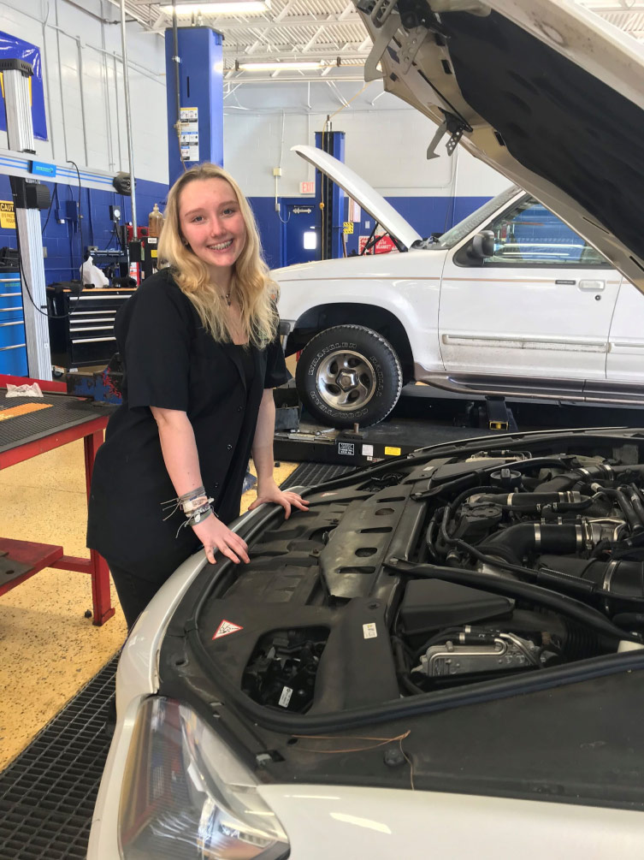
FCTC
Programs
Heating, Ventilation, Air Conditioning/Refrigeration
Landscape & Turf Management
Nursery Management
Automotive Service Technology
Culinary Arts
Diesel Systems Technician
Dental Assisting
Medical Assisting
Welding Technology
Horticulture Science and Services
Culinary Arts
Cosmetology
Facials Specialty
Nails Specialty
Early Childhood Education
What is it?
Dual Enrollment at FCTC in St. Augustine 1-3 periods of school per day based on availability
Certifications and possible job placement after graduation.
How to apply?
You must have a 2.0 GPA unweighted
Good attendance and discipline record
Have transportation to FCTC campus
Enrollment for Spring 2025 is closed
Potential enrollment for summer
Fall 2025 Enrollment is open now, Closes in February programs

Slide 8
Are you test ready? The time is now!
Why test? Most colleges/programs require test scores. Higher test scores=more merit money for colleges. If you need money for college, this is the best way to get it!
Timing: You should prepare to take one, if not all, of these tests once you have completed ALGEBRA 2
How often? You should try each test. Decide which fits you best. Then work on SUPERSCORES.
There is no limit on how many times you can test
Accommodations: If you have a 504/IEP, you must apply for those accommodations with the testing companies.
TCHS TESTING PAGE
SAT
ACT- All TCHS Juniors will take the ACT during the school day in February.
CLT
PERT- for DUAL ENROLLMENT PURPOSES ONLY!

Slide 9
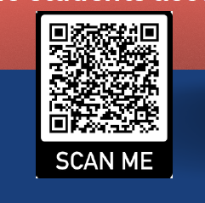
Resources
TEST PREP
Study help
Schoolhouse by KHAN Academy
ACT TEST PREP
SAT TEST PREP
CLT SITE
PERT PREP
Varsity Tutors (Clever-Learning Apps)
-on demand essay review, self study practice,
chat with a tutor, Live Group Classes
Toro Time
Teacher session
Youtube

Slide 10
SCHEDULING
Registration forms will go home in January.
School Messenger message prior to Christmas break about selecting electives
Electives will be picked in HAC
Recommendations for academic courses will be by TEST SCORE AND GRADES, not teacher recommendation
Select Rigor based on your TIME/ABILITY management (whole life balance)
Select Courses based on YOUR path

Slide 11
SCHEDULING
Modified- Shortened school day for eligible students.
  1. Must have earned an acceleration point or be enrolled in an acceleration course for senior year.
  2. Students who have less then a 2.0 OR have not passed their Algebra 1 EOC or Reading FAST will be limited on the number of periods they can be modified.
CO-OP – Shortened school day to go to work.
  1. Same eligibility as modified in addition to work requirement.
  2. Application required & requires a notary- MUST SUBMIT APPLICATION TO HAVE CO-OP PLACED ON SCHEDULE- (Student cannot place CO-OP on your elective schedule when self-selecting)
  3. Students must work a minimum of 5 hours for each period off.
Electives will be picked in HAC
Recommendations for academic courses will be by TEST SCORE AND GRADES, not teacher recommendation
Select Rigor based on your TIME/ABILITY management (whole life balance)
Select Courses based on YOUR path

Slide 12
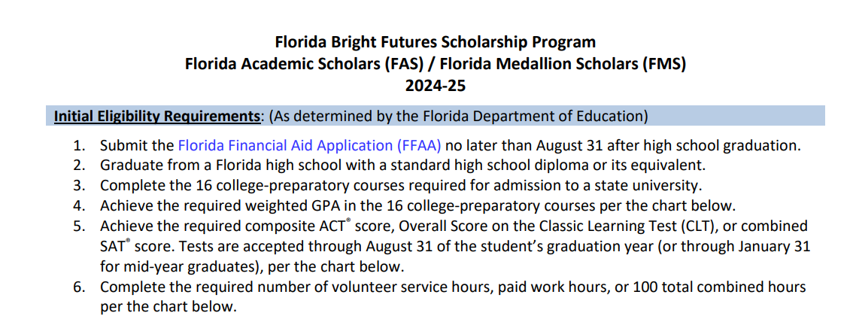
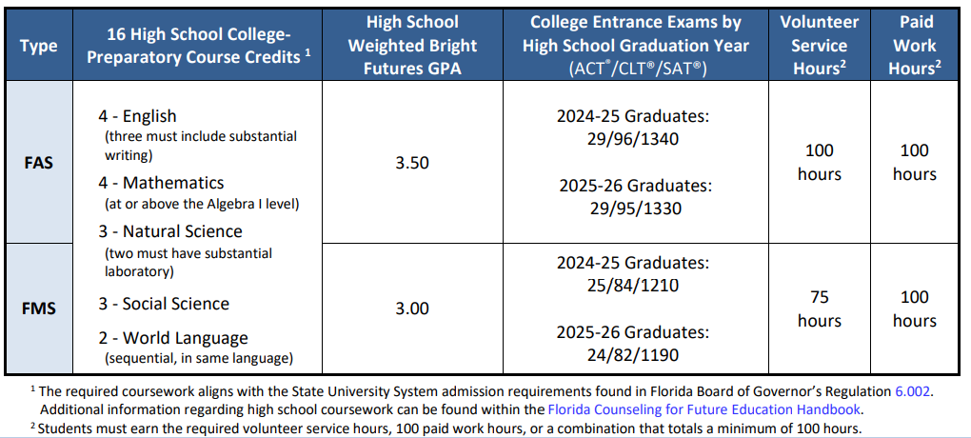
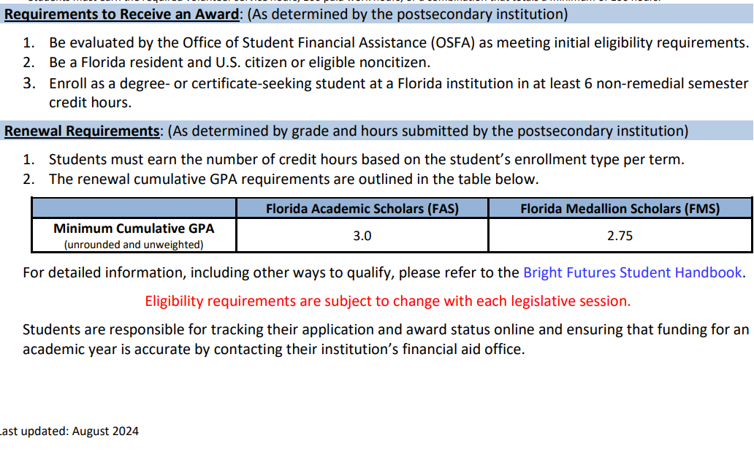
Bright Futures
Eligibility Requirements( ALL 4!)
GPA(based on accepted courses)
TEST SCORES
SERVICE OR WORK HOURS
APPLY by AUG 31st after HS graduation

Slide 13

SJCSD Grade calculation
Summatives:
  Consist of big tests or assignments
  Are weighted 70% of your grade!
  You cannot have a zero on a summative.
  You can retake a summative if you earn less an 85%.
Formatives:
  Consist of quizzes, activities, homework, etc…
  Are weighted 30% of your grade.
  You will get a zero if not turned in.
  You cannot retake a formative

Slide 14
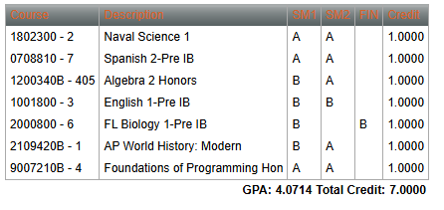
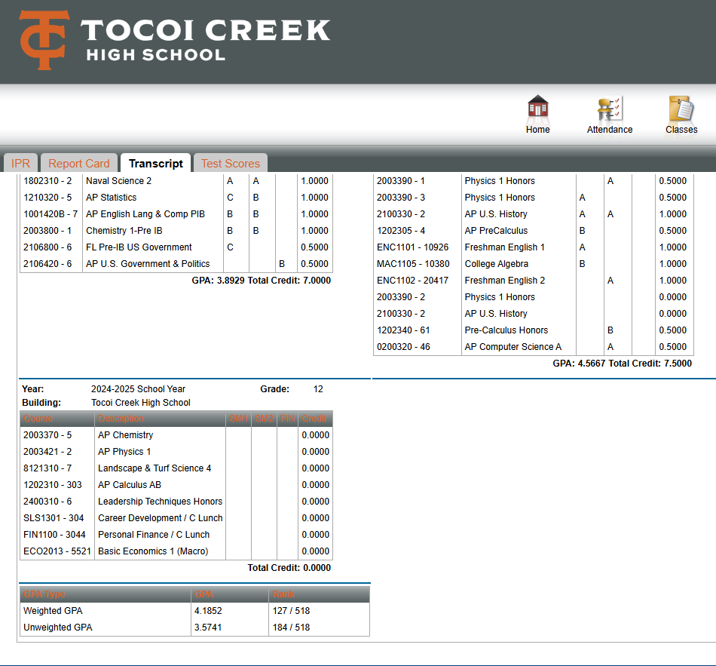
Grades/HAC
Yearlong Course
Semester Course/taken all year
Unweighted/Weighted GPA

Slide 15
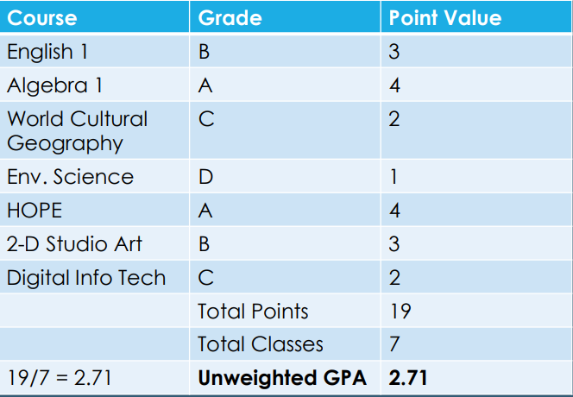
GPA
You can try your hand at calculating your GPA for colleges GPA calculator
( HAC provides a cumulative high school unweighted and weighted GPA for you.
Unweighted Rules
The grade for each course is assigned a number (A=4,B=3,C=2,D=1,F=0)(4.0 scale)
Total up the number of points earned for each course on your transcript
Divide total by number of grades you enter
Used for graduation requirement purposes
ie: 4.0 + 4.0 + 4.0 + 3.0 + 3.0 = 18
Unweighted GPA = 18/5 = 3.6 out of 4.0
Weighted Rules
Honors classes are on a 4.5 scale( get a .5 boost)
AP & Dual Enrollment are on a 5.0 scale (get a 1.0 boost)
GPA’s get recalculated in January and June based on previous semester grades
Used for class rank Senior Year
Weighted
GPA Points
A:5
B:4
C:3
D:2
F: 0
Unweighted
GPA Points
A:4
B:3
C:2
D:1
F:0

Slide 16

-85% of what you show colleges on your application is currently completed.(Jan 2025)
-Transcripts post with letter grades NOT numbers. The colleges will not see you earned an 89. Remediate and retest to get the A.
-Rigor Matters! Taking Honors, AP, AICE, Dual Enrollment shows colleges you want to push yourself academically.
-Eligible for Dual Enrollment? Check TCHS webpage/School Counseling/Dual Enrollment/Test Scores to see what you need for eligibility.
-Revise summer plans not to enhance your resume for college- take an extra class- internships/shadowing-volunteer-work-something to set you apart
-Time to talk about what’s next with family –college -4 year -2 year -trade school –military -financial aide-locations-in state/out of state -workforce -apprenticeship -Gap year
Does this matter?

Slide 17
Study skills
Time Management
Communication skills
Adaptability especially when uncomfortable
Critical thinking
Collaboration/Team Work
Goal Setting
Digital Literacy
Resilience
Problem-Solving
-Establish Successful Study Skills
-Develop Organization Skills
Calendar, phone, planner
-Check emails daily
(Still the main means
of business communication)
-Work to Self-Advocate and
communicate needs effectively
-Work on being adaptable/flexible
-Question, rethink, evaluate
for better understanding
-Set Goals -5 year and short term
-Resilience- ability to
bounce back without giving up
Tools for success

Slide 18

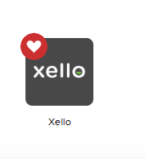
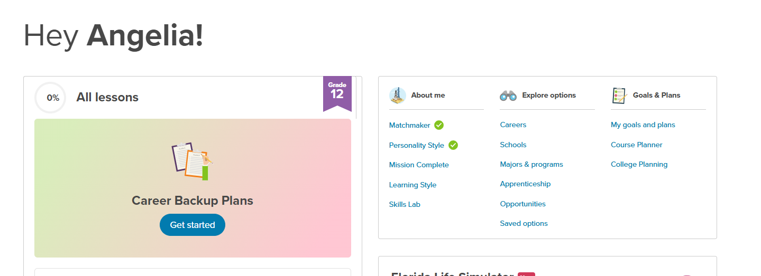
Still wondering what’s next for you?
Try these resources inside XELLO
Xello application through Clever under Student Applications
Complete these surveys for career suggestions based on your answers

Slide 19
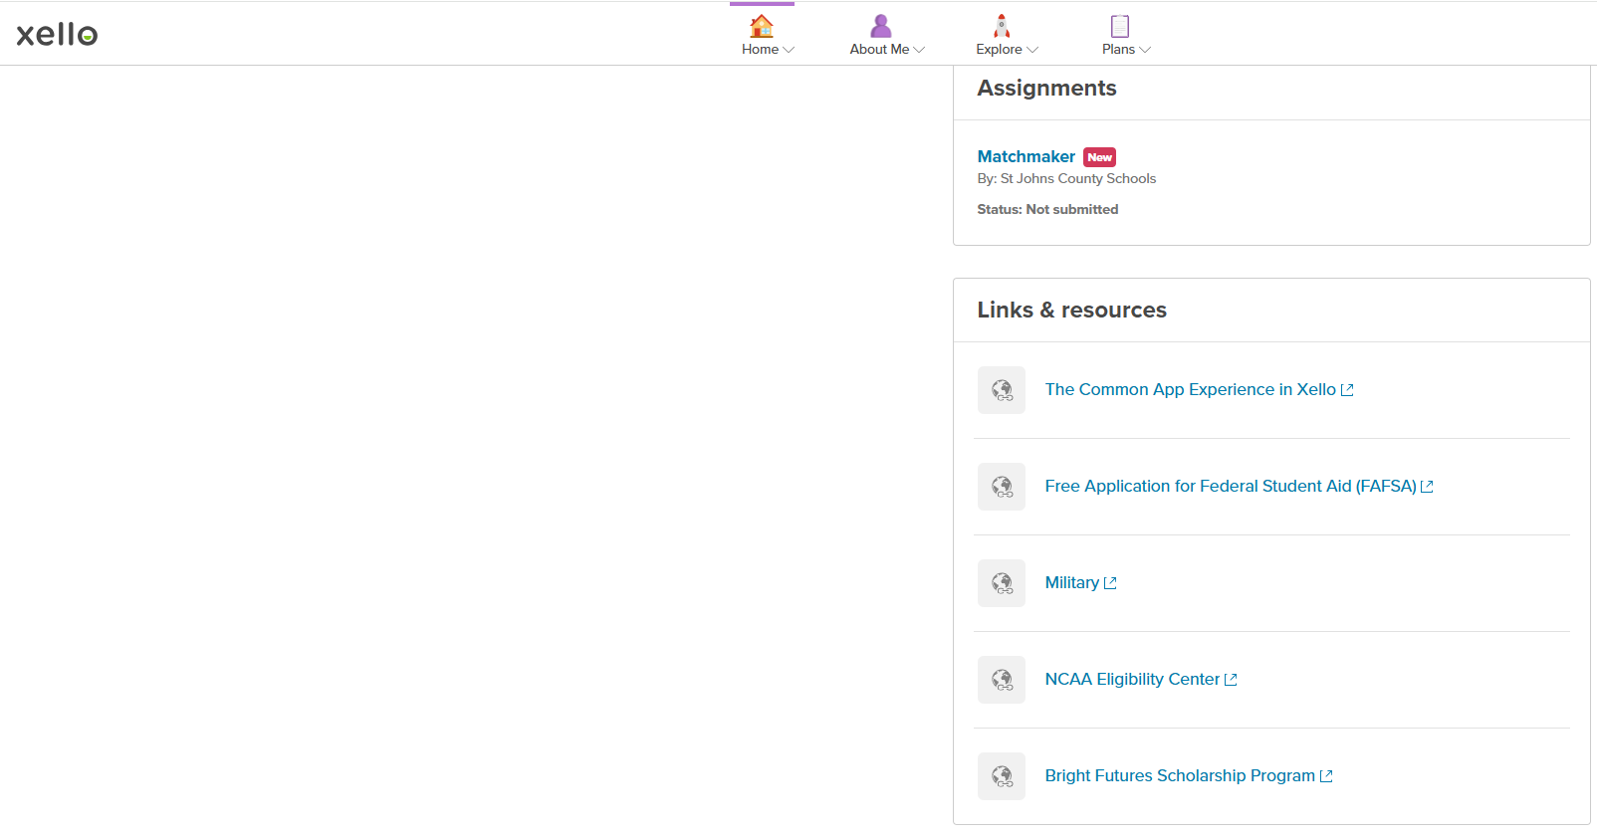
Xello Resources
Click here to find the most up-to date information
through the appropriate links

