Slide 1
Succeeding in 11th Grade and Beyond
Tocoi Creek School Counseling

Slide 2
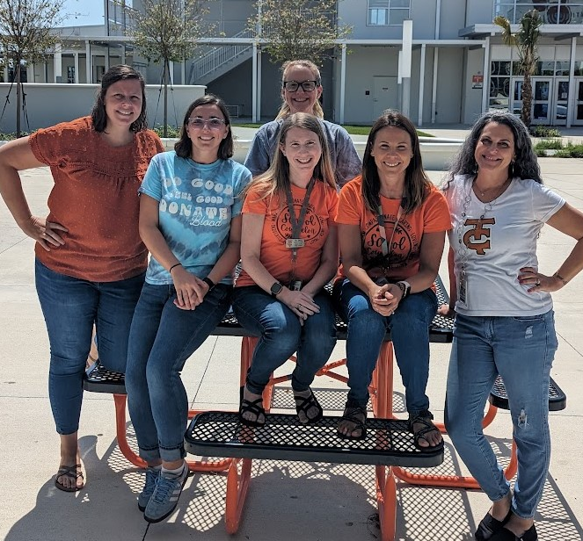
Tocoi Creek Counseling Department
Elizabeth Wright Early College Program & A’s
Artina Coma B-Dh
Laura Kuhel Di-I
Alyssa Socket J-Ml
Rachel Blount Mo- Sa
Linda M. Smith Sc-Z
Susan Basil Guidance Secretary

Slide 3
School News: How to Stay in the Know…
School Counselor Website
https://www-tchs.stjohns.k12.fl.us/guidance/
Schoology
JOIN THE SCHOOL COUNSELOR SCHOOLOGY
GROUP: 42BP-PCPC-Q5DCN
School Website-Student Life Section
https://www-tchs.stjohns.k12.fl.us/
BullPen Newsletter
Twitter
Instagram
Counseling Office Exterior Glass (1st and 3rd Floor)

Slide 4
Graduation Requirements
Florida students must earn a minimum of 24 credits to graduate.

Slide 5
If you’re planning to attend college, you will need two credits in the SAME world language.

Slide 6
Calculating Unweighted GPA
Sample Freshman Schedule:
Breakdown of Points:
A – 4 points
B - 3 points
C - 2 points
D – 1 point
F – 0 points

Slide 7
What you need to know about GPA
Unweighted GPA Points:
A: 4
B: 3
C: 2
D: 1
F: 0
Weighted GPA Points
A: 5
B: 4
C: 3
D: 2
F: 0
GPA’s update after every semester:
In January, after semester 1 grades post
In the summer, after semester 2 grades post
AP, Dual Enrollment, and honors counts towards your weighted GPA
Standard classes are on a 4.0 scale
Honors classes are on a 4.5
Dual Enrollment & AP courses are on a 5.0 scale
Why does GPA Matter?
Universities review you GPA in academic classes for admission.
Dual enrollment with SJR requires a 3.0 GPA unweighted.
First Coast Technical College requires a 2.0 GPA unweighted.
You need a 2.0 GPA unweighted to graduate!

Slide 8
REMINDER:
HOW ARE GRADES CALCULATED?
Summatives:
Consist of big tests or assignments
Are weighted 70% of your grade!
You cannot have a zero on a summative.
You can retake a summative if you earn less an 85%.
Formatives:
Consist of quizzes, activities, homework, etc…
Are weighted 30% of your grade.
You will get a zero if not turned in.
You cannot retake a formative.

Slide 9
66% of the grades you will send to universities are done.

Slide 10
St. Johns River Dual Enrollment Requirements
3.0 GPA unweighted
PERT test on file
Qualify for English and math courses through meeting Pert, ACT or SAT score requirement.
Have transportation for courses on campus.
Benefits of Dual Enrollment with SJR
Earn college credits without end-of-year exam.
Increase weighted GPA
Gain college-level course experience
Earn college credits for free!
How to Apply
Talk to your school counselor during registration.
Take the PERT test.
Complete the dual enrollment registration on the SJR website.
Watch Schoology for updates.
Work with your counselor to choose courses either at TCHS, online, or at SJR.
LOOKING TO THE FUTURE
College Credit with Dual Enrollment

Slide 11
Dual Enrollment Interest Sessions December 6th or 20th Toro Time in the Auditorium
You must attend a session if you will do dual enrollment with St. Johns River. Sign up that week in the first-floor guidance office.
Add Schoology code: RCGS-QGPH-RZCG6

Slide 12
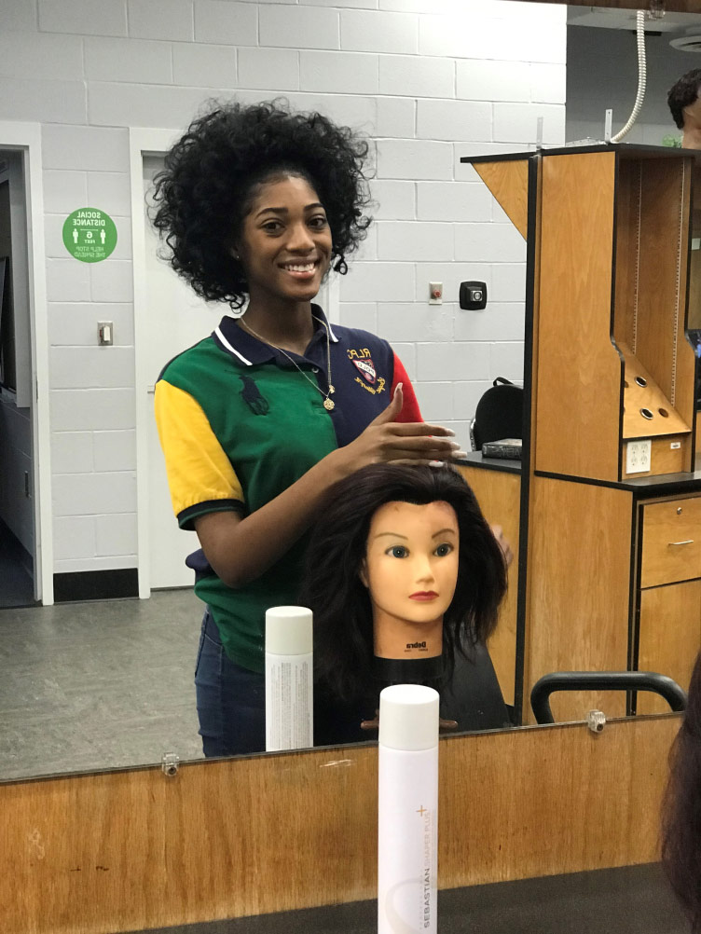
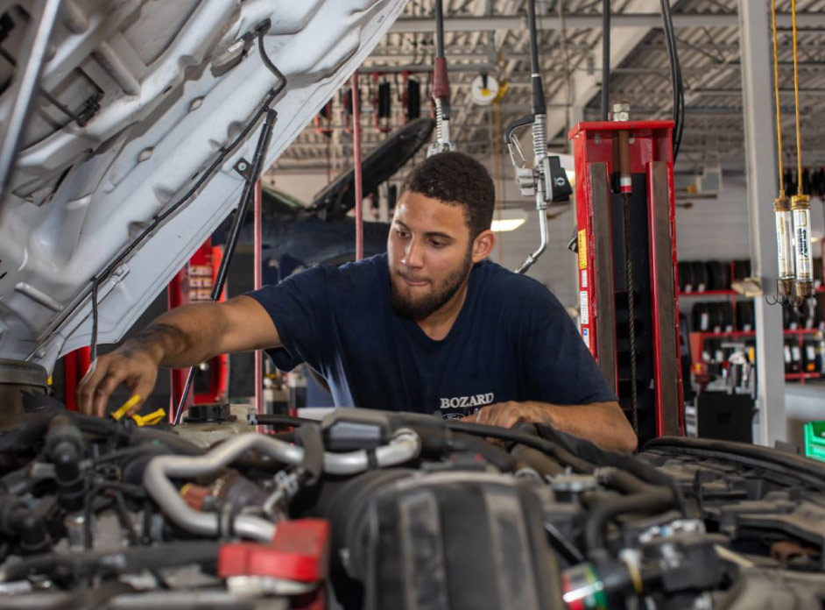
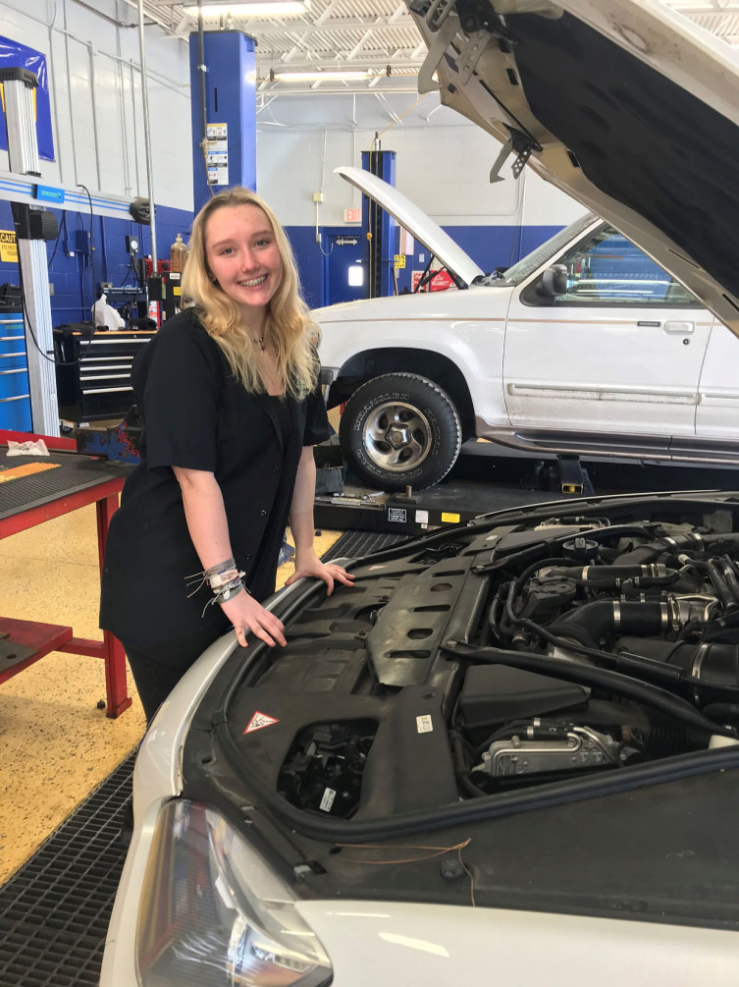
FCTC
Programs
Heating, Ventilation, Air Conditioning/Refrigeration
Landscape & Turf Management
Nursery Management
Automotive Service Technology
Culinary Arts
Diesel Systems Technician
Dental Assisting
Medical Assisting
Welding Technology
Horticulture Science and Services
Culinary Arts
Cosmetology
Facials Specialty
Nails Specialty
Early Childhood Education
LOOKING TO THE FUTURE
FIRST COAST TECHNICAL COLLEGE
What is it?
Dual Enrollment at FCTC in St. Augustine 1-3 periods of school per day.
Certifications and possible job placement after graduation.
How to apply?
You must have a 2.0 GPA unweighted
Good attendance and discipline record
Have transportation to FCTC campus
Apply with school counselor. Opens January, Closes March 11th.

Slide 13
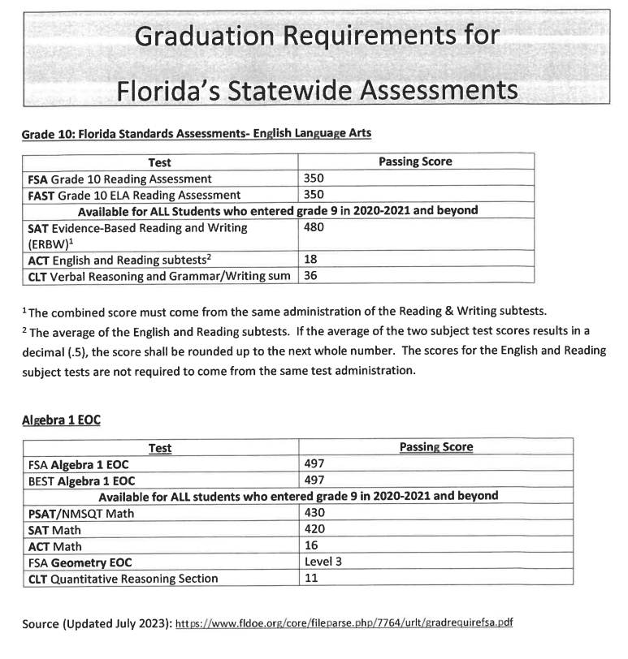
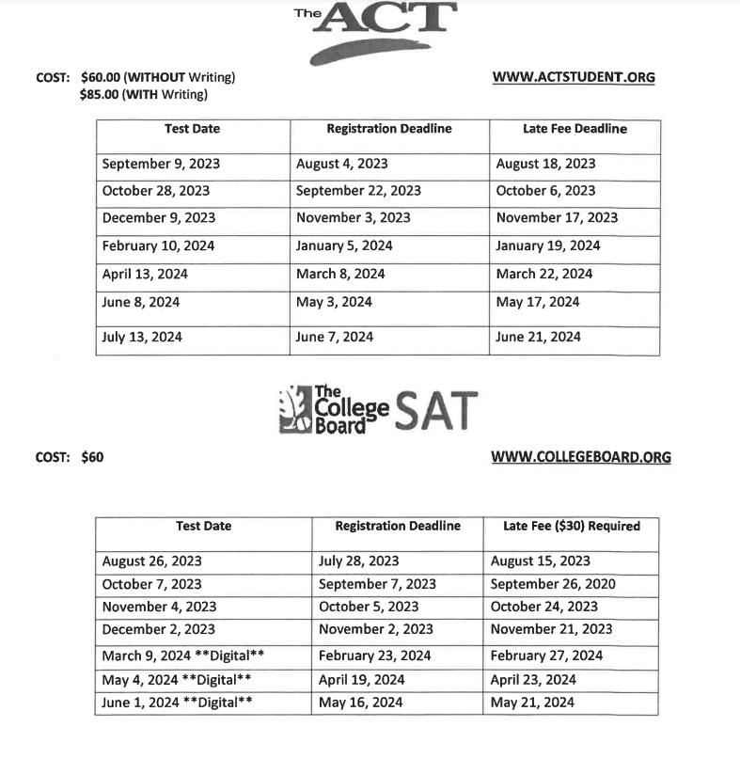
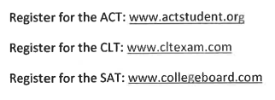
Post-Secondary and Concordant Testing Information
Most colleges and Bright Futures have a testing requirement to determine eligibility. Even if schools state that they are 'test-optional,' often, you will still need testing to qualify for additional scholarships at the school you are applying.

Slide 14
WHAT ARE COLLEGES LOOKING FOR? Well-rounded students GPA Recalculated Test scores (ACT, CLT, and SAT) Rigor of Courses (Dual Enrollment, AP, Honors) Extra-curricular and leadership activities – Quality, not Quantity Your Essay. Your story. Teacher recommendations for some universities

Slide 15
Florida SUS Matrix

Slide 16
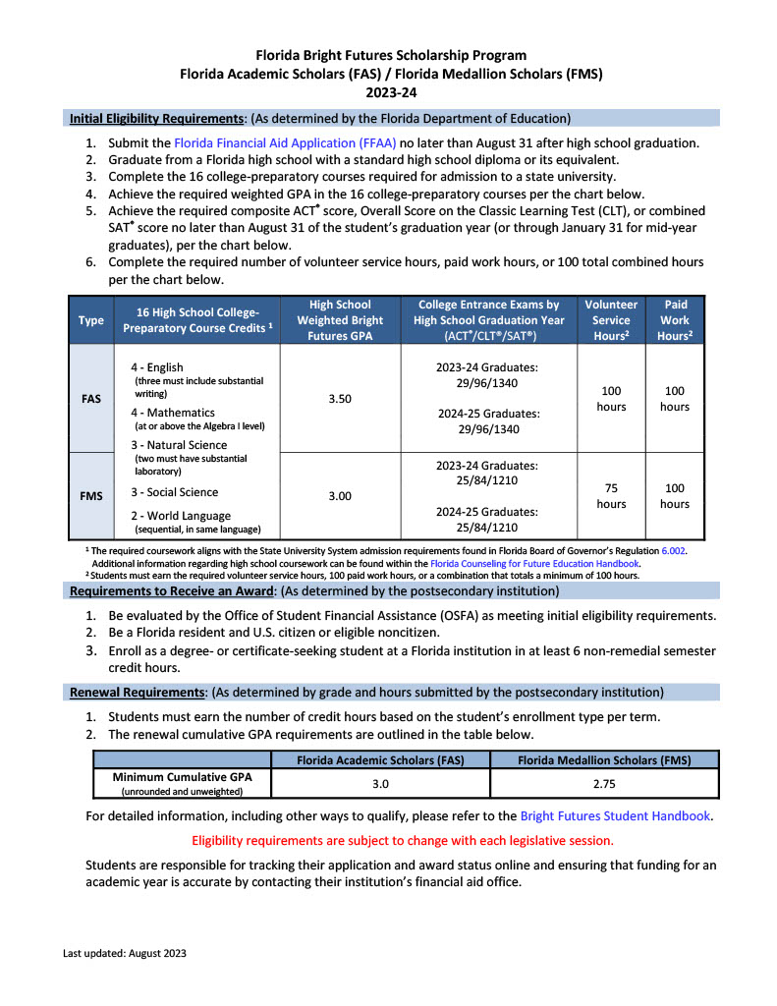
Bright Futures
Bright Futures will recalculate your GPA based on the 16 credits listed on the table to the right
If you have more credits in one or more of the categories e.g. you have 4 science credits, they will take your best 3 for eligibility
Submit your service/work hours by the end of your junior year to ensure that portion of your scholarship is already entered
75 for Medallion Scholarship
100 for Academic Scholarship
Consider taking the ACT/SAT/CLT in the spring of your junior year, if you are college bound, to have baseline scores and determine Bright Futures eligibility
Bright Futures is an automatic scholarship that covers the academic portion of 4-year university, trade school, or community college
All students should apply October of their senior year, regardless of your post-secondary plans

Slide 17
11th Grade Checklist
Career shines
College/Career Exploration
Senior Scheduling (Strength of Schedule)
Planning an ACT/SAT/CLT exam for spring of junior year if you are college bound to get baseline scores
Submitting service/work hours for Bright Futures eligibility

Slide 18
Seek Assistance
Did you plan a time to do a career assessment? (Career Shines or Naviance)
Do you use Toro Time to meet with teachers?
Do you take advantage of NHS tutoring?
Do you and your guardian communicate challenges with your teacher?
Ask someone who supports you at home to hold you accountable?

Slide 19
Get Organized
Do you use your planner to write down homework & test dates?
Do you check your HAC to make sure you turned in assignments?
Do you check Schoology to review classwork?
How do you organize your backpack?
Do you set aside a time to plan for the week?

Slide 20
Get Involved
Look to get involved with our school community. This is a great way to begin your resume. Look for virtual community service opportunities as well.
Check out the Clubs and Activities Section on the Tocoi Creek High School website for a full list of clubs.
Can’t stay after school? Multiple clubs meet during Toro Time if you do not have an obligation.

Slide 21
Community Service and Work Hours
Not needed for graduation
Needed for $$ (scholarships, including Bright Futures)
Community service verification letters and work hours can be turned into the school counseling offices on the 1st and 3rd floor of the academic building
Your goal should be to finish 100 hours of community service by the end of 11th grade
We suggest students keep a copy of the community service verification letters and submit hours as they are completed (Do not wait until senior year and have 200 hours)
Students may now combine work and service hours for Bright Futures eligibility

Slide 22
School Counselors are Here to Help
We know that we are living in a time where we are presented with multiple challenges
The next few slides discuss stress & anxiety & what you can do to alleviate some stressors in your lives.

Slide 23
What can I control?
How I treat others?
What I post on social media?
That formative I failed last week?
Being cut from my sports team?
Not being invited to an event?
Joining a new club?
Talking to my teacher when I am struggling?
Being kind to everyone?

Slide 24
Help Promote Student Safety and Wellness
Think before you post on social media if it could be harmful to others.
Tell someone. If you witness bullying online or in school, tell a trusted adult, your counselor or the dean's office.
Demonstrate Kindness. This is checking yourself:
Don’t talk negatively about peers to others
Don’t post unkind things on social media.
Don’t involve yourself in other student’s negative interactions.
Aim to be kind to all students. That kindness may change their day.
Drama can be tiring, leading to anxious feelings and lack of concentration and sleep.

Slide 25
Please Come Talk to Us
Life Stuff:
You have too much between school and home
You are worried about the future
You don’t have clothing for school
Your family is having trouble affording food and toiletries.
You don’t have money to bring or buy lunch
You are feeling sad or anxious
You are concerned about a friend
School Stuff:
- You need help organizing yourself
You are overwhelmed by classwork
You don’t know how to talk to a teacher
You are struggling in classes
You want to make new friends
You feel negative at school
You want to check in to say hi!
Make an appointment online or at the guidance office:
Emergency: Talk to the counseling secretary
Nonemergency: Make an appointment

Slide 26
Resources to Use
Florida College Access Network:
https://floridacollegeaccess.org/initiatives/crf-toolbox/
2. Naviance through Clever for Career and college match and exploration.
3. Florida shines career and college exploration.
https://www.floridashines.org/

