Slide 1
Welcome to 9th Grade!
Tocoi School Counseling Team

Slide 2
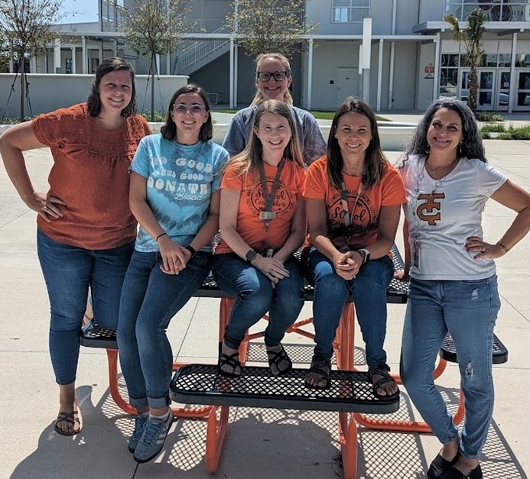
Counseling Department
Elizabeth Wright Early College Program & A’s
Artina Coma B-Dh
Laura Kuhel Di-I
Alyssa Socket J-Ml
Rachel Blount Mo- Sa
Linda M. Smith Sc-Z
Susan Basil Guidance Secretary

Slide 3
School News: How to Stay in the Know…
School Counselor Website
https://www-tchs.stjohns.k12.fl.us/guidance/
Schoology
JOIN THE SCHOOL COUNSELOR SCHOOLOGY GROUP: 42BP-PCPC-Q5DCN
School Website-Student Life Section
https://www-tchs.stjohns.k12.fl.us/
BullPen Newsletter
Twitter
Instagram
Guidance Offices Exterior Glass (1st and 3rd Floor)

Slide 4
Requirements for Standard 24 Credit Diploma
Assessments (Algebra 1 EOC and Grade 10 ELA)
2.0 Cumulative, Unweighted GPA
24 specific credits
8 Elective Credits, which must include one .5 credit of Personal Financial Literacy

Slide 5
Assessments
Must pass two assessments to graduate with diploma (otherwise you earn a Certificate Of Completion)
Algebra 1 EOC (level 3 or above) or
ACT Math – 16 or
SAT Math – 420 or
PSAT/NMSQT Math – 430 or
FSA Geometry EOC – 499
CLT Quantitative Reasoning Exam 11
Grade 10 ELA (level 3 or above) or
ACT Reading and English average – 18 or
SAT Evidence-Based Reading and Writing – 480
CLT Verbal and Grammer/Writing Sections-36
If you earn a COC that means you did not graduate from high school and your post-secondary options are limited

Slide 6
Graduation Requirements
Florida students must earn a minimum of 24 credits to graduate

Slide 7
If you’re planning to attend college, you will need two credits in the SAME world language.
Must earn 8 elective credits, .5 credits must now be in personal financial literacy

Slide 8
Progression Requirements
9th to 10th Grade
5 credits
10th to 11th Grade
11 credits
11th to 12th Grade
17 credits

Slide 9
Community Service and Work Hours
Not needed for graduation
Needed for $$ (scholarships, including Bright Futures)
Community service verification letters and work hours can be turned into the school counseling offices on the 1st and 3rd floor of the academic building
Your goal should be to finish 100 hours of community service by the end of 11th grade
We suggest students keep a copy of the community service verification letters and submit hours as they are completed (Do not wait until senior year and have 200 hours)
Students may now combine work and service hours for Bright Futures eligibility

Slide 10
What you need to know about GPA
GPA’s update after every semester:
In January, after semester 1 grades post
In the summer, after semester 2 grades post
AP, Dual Enrollment, and honors counts towards your weighted GPA
Standard classes are on a 4.0 scale, honors classes are on a 4.5, and Dual Enrollment & AP courses are on a 5.0 scale
Only unweighted GPA counts towards graduation and qualifications for Dual Enrollment

Slide 11
Calculating Unweighted GPA
Sample Freshman Schedule:
Breakdown of Points:
A – 4 points
B - 3 points
C - 2 points
D – 1 point
F – 0 points

Slide 12
WHAT ARE COLLEGES LOOKING FOR? Well rounded students GPA (grade point average) Test scores (ACT and SAT) Community service hours Rigorous courses taken (Dual Enrollment, AP, Honors) Extra-curricular and leadership activities – Quality, not Quantity

Slide 13
How To Guide for a....
Successful 9th grade year

Slide 14
9th Grade Checklist
Get Organized
Seek Assistance
Get Involved
Set Goals
Be an Advocate
Begin Community Service

Slide 15
9th Grade Checklist
Get Organized
Create a system to help you stay organized with school assignments, summative dates, formatives, etc.
Get Involved
Look to get involved with our school community. This is a great way to begin your resume. Look for virtual community service opportunities as well.
Community Service
Get involved with a non or not-for-profit company to earn service hours. There is no such thing as too many!
Seek Assistance
Get help if necessary. Take advantage of tutoring opportunities offered through National Honor Society, teachers, and Toro Time
Communication is key
YOU are your BEST advocate! Communicate with your teachers - face to face or through email, ask questions in class, or attend Toro Time sessions.

Slide 16
School Counselors are Here to Help
We know that we are living in a time where we are presented with multiple challenges
The next few slides discuss stress & anxiety & what you can do to alleviate some stressors in your lives.

Slide 17
Anxiety & Stress
■Managing stress and anxiety is an important tool for everyday life
■Anxiety can be the result of stressful situations and/or clinical disorders.
■Stress and anxiety can overlap but differ in the duration and intensity.
■This resource is intended to provide tools to manage everyday anxiety and stress, as well as coping during stressful life events, such as COVID-19.

Slide 18
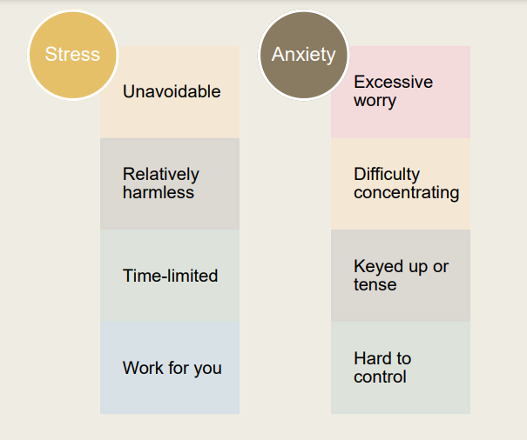
General Stress vs. Anxiety
Notes:
STress and anxiety are there because it activates the flight, fight or freeze response. How are we going to handle the different stressors that are presented to us. We just discussed gpa and why its important. Some of you may now be feeling stressed or anxious about what we just discussed related to your gpa. The good news is this feeling of anxious or stressed is appropriate because it means you care.

Slide 19
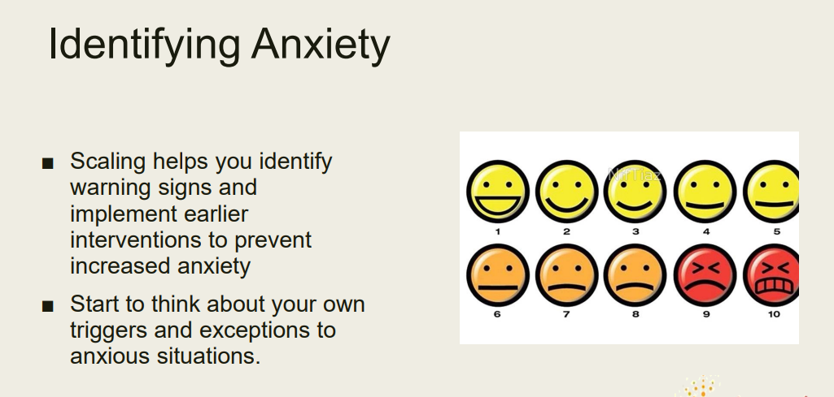
How do you know when you’re stressed or anxious?

Slide 20
The goal here is to be less reactive
Notes:
Breathe in 3 hold 4 and blow out 5. Give sports situation in practicing

Slide 22
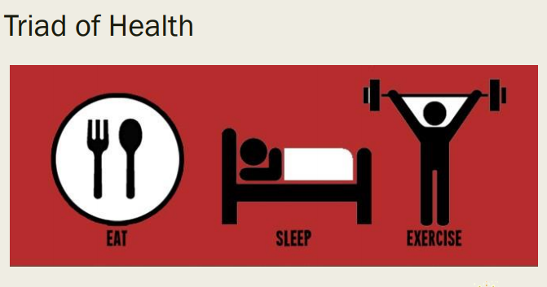

Slide 23
Techno Stress
■ Describes stress related to the use of internet and electronics.
■ It can be caused by daily use of computer technology.
■ Find ways to get off-line and engage in other forms of healthy self-care activities.
Notes:
No judgement, but try turning on the tracking your phone use to see how much of your time is spent on your phone

Slide 24
Take a break from the news and social media
Care for your body through sleep, diet, exercise, meditation
Unwind by engaging in activities you enjoy
Connect and talk with others – express your concerns and talk about how you’re feeling
Engage in fun activities with your family that do not involve talking about the current pandemic
Talk with your Counselor
Fortify FL App
More Ways to Support Yourself During Stressful Times

Slide 25
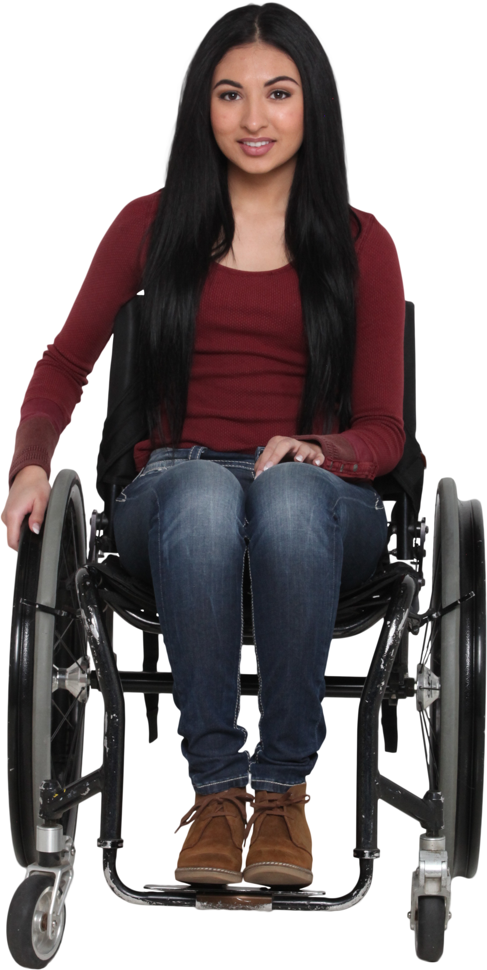
Please Come Talk to Us
Life Stuff:
You have too much between school and home
You are worried about the future
You don’t have clothing for school
Your family is having trouble affording food and toiletries.
You don’t have money to bring or buy lunch
You are feeling sad or anxious
You are concerned about a friend
School Stuff:
- You need help organizing yourself
You are overwhelmed by classwork
You don’t know how to talk to a teacher
You are struggling in classes
You want to make new friends
You feel negative at school
You want to check in to say hi!
Make an appointment online or at the guidance office:
Emergency: Talk to the counseling secretary
Nonemergency: Make an appointment

